Slide 1
Cultivating Trauma-Informed Spaces in Education
CICMH November 3, 2022
Nicole Johnson (she/her), SSW Program Professor, FAHCS
Ida Gianvito (she/her), Counsellor, Wellness

Slide 2
Agenda
Welcome & Introductions
Land Acknowledgment
Context: Trauma & Prevalence
Research Project Background
Our Framework: Trauma-Informed Education Grounded in a Systemic Analysis & Working Assumptions of Trauma/TIE
Cultivating Trauma-Informed Spaces Together-Sample Strategies
Why We Should Care About Trauma-Informed Education
Contact Information & Questions

Slide 3
We recognize that some of the slides on trauma are sensitive in nature and may bring up a range of emotions.
We encourage you to use grounding/centering tools and wellness strategies if you feel uncomfortable or activated by the content.

Slide 4
Land Acknowledgment
Sheridan is covered by the Dish with One Spoon treaty and the Two Row Wampum treaty which emphasize the importance of joint stewardship, peace, sovereignty, respectful relationships, and reciprocity. We recognize the land on which we gather has been and still is the traditional territory of several Indigenous nations, including the Anishinaabe, the Haudenosaunee Confederacy, the Wendat, the Mississaugas of the Credit First Nation and the Métis. Since time immemorial, numerous Indigenous nations and Indigenous peoples have lived and passed through this territory.

Slide 5
Land Acknowledgment
As settlers we are grateful to be living and working on this land. It is our collective responsibility to honour and respect those who have gone before us, those who are here, and those who have yet to come. We recognize and pledge to advocate for change by helping to lift the voices of Indigenous people as they fight for the well-being of their communities and in our commitment to Truth and Reconciliation.
We would like to acknowledge the work of Indigenous peoples at Sheridan and in the community that are making a difference for future generations. We honour the resilience of Indigenous knowledge and their application of Trauma-Informed Practices.

Slide 6
Our Working Definition of Trauma?
Trauma is a subjective response to an expected or unexpected event, collection of events, repetitive experiences, or the cumulation of multiple experiences; that compromises an individual’s sense of safety and control (adapted from Klinic Community Health Centre, 2013). Trauma can take different forms, such as single incident, complex or repetitive, developmental, historical, and intergenerational (Klinic Community Health Centre, 2013), and intersects with racism and various forms of oppression. It is best defined by the person that experiences it.
Trauma responses can impact a person in a multitude of ways including economically, emotionally, behaviorally, physically, psychologically, relationally, and spiritually. Trauma can be both an individual and collective experience, often the result of systemic oppression, patriarchy, colonization, and social determinants of health.
I

Slide 7
Definition Continued
Trauma can result from individual’s daily engagement navigating the very systems intended to support people, including the health care, social service, education and criminal justice system.
Trauma can also result from demonstrating empathy and compassion for others, often referred to as Compassion Fatigue (Carla Joinson, 1992), Vicarious Trauma (Pearlman & Saakvitne, 1995), and Empathic Distress (Singer & Klimecki, 2014).
I

Slide 8
Context: Prevalence of Trauma
In Canada, 76% of adults report some form of trauma exposure in their lifetime, with 9.2% meeting the criteria for Post-Traumatic Stress Disorder (Government of Nova Scotia, 2015).
The COVID pandemic heightened societal inequities and experiences of trauma, so we suspect the rates of trauma experiences as much higher today.
71% of students at Canadian postsecondary schools either witnessed or experienced unwanted sexualized behaviours in a postsecondary setting. (Burczycka, 2020).

Slide 9
Research Project Background
2020 - identified a need to address trauma and enhance student support, learning experiences and reduce trauma, retraumatization, and vicarious trauma.
Collaboration between the School of Community Studies Department and Student Affairs.
2021-2022 - Research project entitled “Developing a Trauma-Informed Practice Framework”.
Funded by the Sheridan Scholarship, Research, and Creative Activities (SRCA) 2021-2022 Growth Grant.
A Trauma-Informed Practice approach and an Equity, Diversity, and Inclusion lens were infused into the research design, process, and dissemination plan.

Slide 10
Research Project Background
The research study employed a community-driven approach, drawing from the voices of key partners, including students, faculty, employees, & community-based agencies.
Supported by a comprehensive literature review.
Close to 100 participants. 18 focus groups & 11 interviews with partners from across Sheridan. A Community of Practice Forum was held with 9 social service agencies from Peel, Halton and surrounding areas.
Outcomes: Development of a framework called “Trauma-Informed Education Grounded in a Systemic Analysis”; A Promising Practices Manual; and general recommendations for a Sheridan-wide Trauma-Informed Education framework.

Slide 11
Trauma-Informed Education Grounded in a Systemic Analysis
Is a multi-faceted pedagogical approach and practice which integrates principles of Equity, Diversity, and Inclusion, Anti-Racism and Anti-Oppression, Harm Reduction, and Universal Design of Learning.
It builds upon Harris & Fallot’s (2001) term “Trauma-Informed Practice” and the five core values of trust, safety, choice, collaboration, and empowerment.
Recognizes the prevalent and systemic nature of trauma.
Is a system wide approach and practice that is best implemented across macro, mezzo, and micro systems to effect real change.
Note: we have a fuller definition.

Slide 12
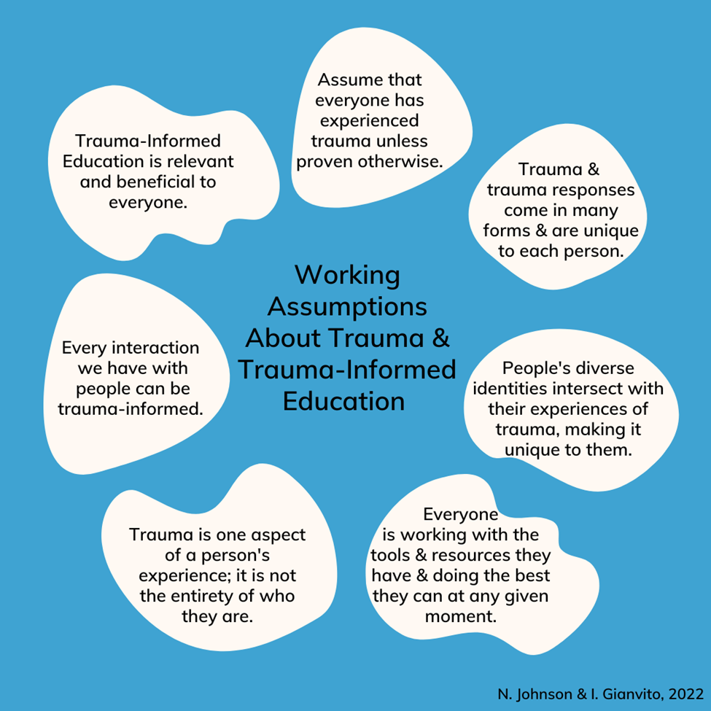
What is Trauma?
“If we apply Trauma-Informed Practice at Sheridan, we lay the foundation for the creation of a safe and brave space”
(Sheridan Employee, 2021).
I

Slide 13
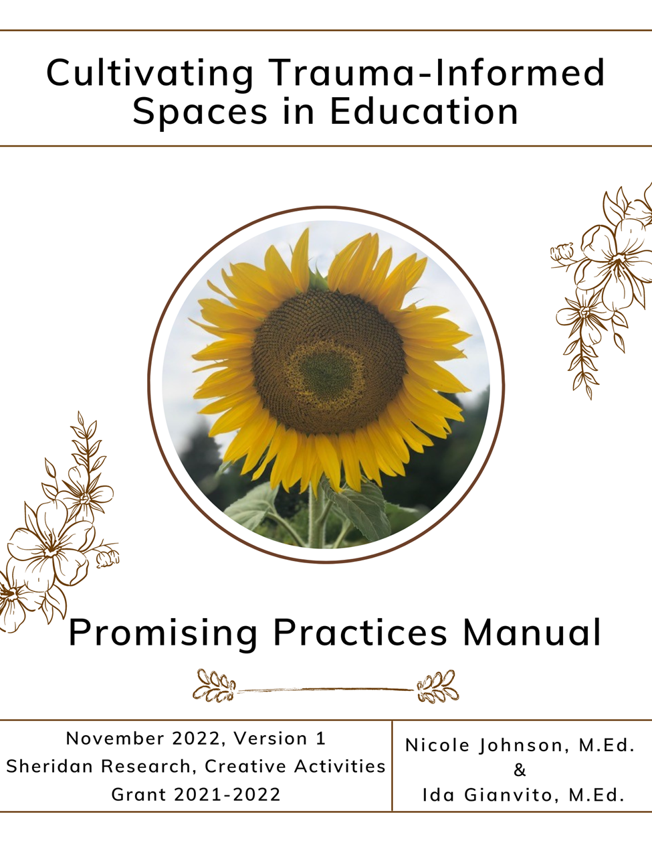
Promising Practices Manual
Cultivating Trauma-Informed Spaces in Education Promising Practices Manual:
Section 1: Foundations (glossary, information on trauma, Trauma-Informed Practice and Education)
Section 2: Framework and Promising Practices (macro, mezzo and micro level- strategies to implement)
Section 3: Practice Activities (case scenarios, reflective practice, and further reading)
This manual was the result of the recommendations and strategies from the research study participants, the literature review and researchers. We are grateful to all of the co-creators of this manual.

Slide 14
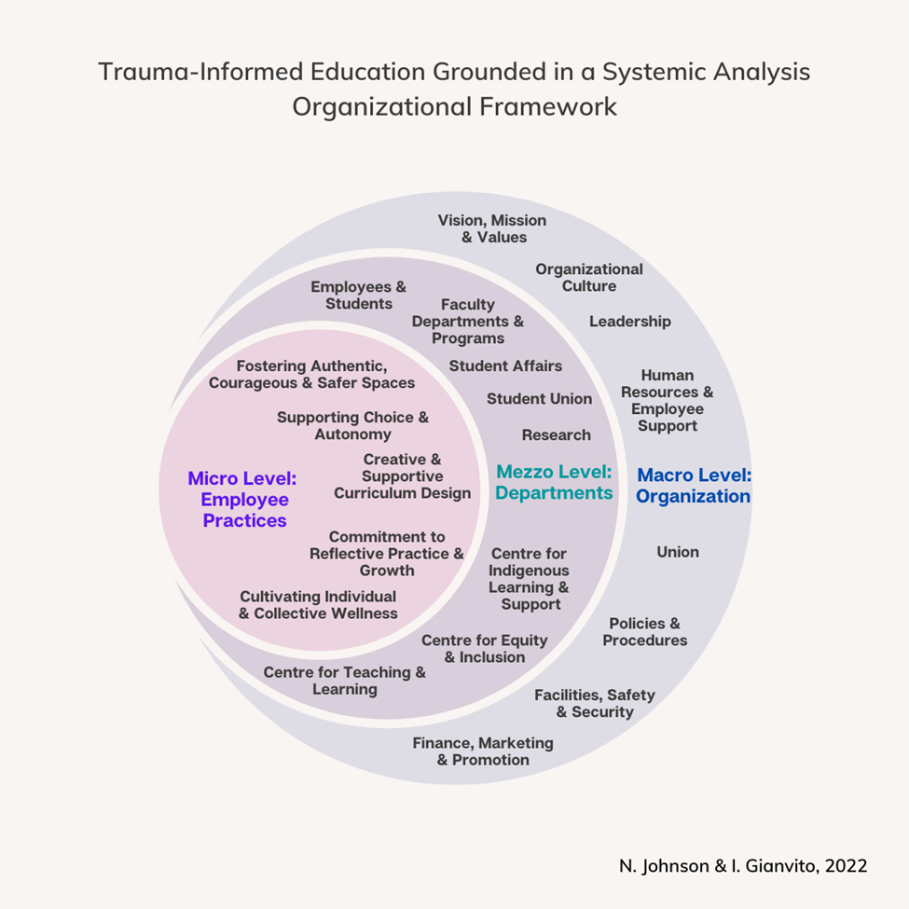
“We need to identify policies and practices that have been in place for some time and identify when they are in conflict with Trauma-Informed Practice, and renegotiate those, and have policies and practices in place that complement Trauma-Informed Practice”
(Faculty, 2021).

Slide 15
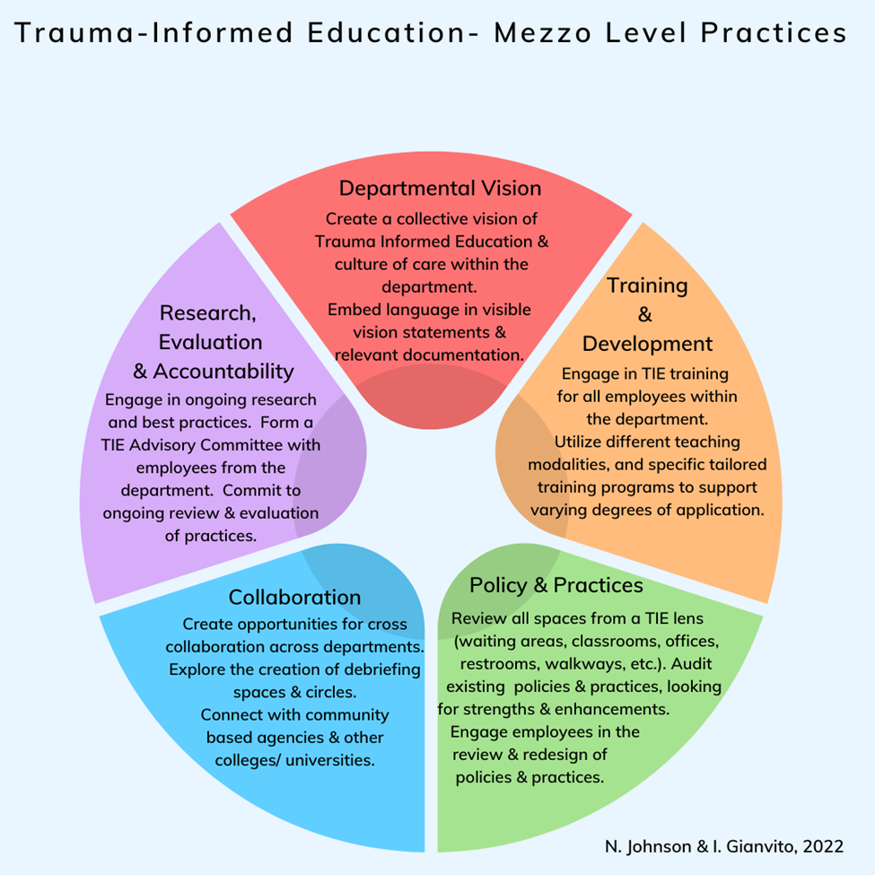
Mezzo - Level Strategies
“Trauma-Informed Practice needs to be a culture within each program as opposed to a culture within an individual classroom” (Employee, 2021).

Slide 16
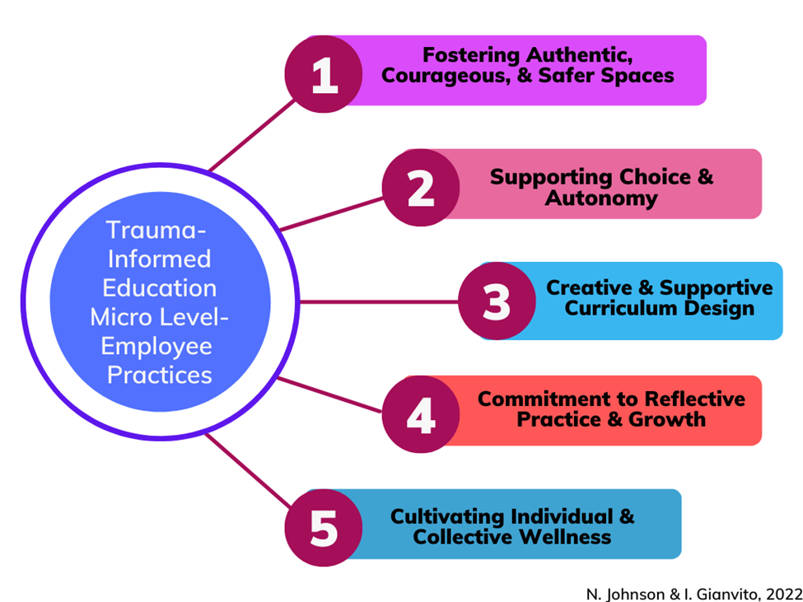
Micro - Level Strategies
“Trauma-Informed Practice is a way of reaching people with what they need, as opposed to what it is that we think that they need”
(Community Agency, 2021).

Slide 17
Cultivating Trauma-Informed Spaces Together: Sample Strategies
Recognize the universality of trauma, root sources of trauma & the impacts.
Re-evaluate your current practices and how your practices may inadvertently cause harm, trauma, re-traumatization, and vicarious trauma (i.e curriculum violence, shock value stories, rigid policies, being trauma ‘indifferent’).
Reflect on how you ‘hold’ space, cultivate and contribute to space (social location, practice cultural humility, commit to anti-racism and anti-oppression).
Recognize your own historical and current experiences of trauma and how it may impact your practices and well-being.

Slide 18
Cultivating Trauma-Informed Spaces Together: Sample Strategies
Disrupt deficit based and pathologizing beliefs about learners and employees. Bring empathy and understanding to learner and employee behaviors.
Assume people’s behavior has a purpose. Recognize the responses to trauma (7 f’s- flock, fight, flight, freeze, flood, fawn, flop).
Recognize it takes vulnerability, courage and strength to bear witness to the pain of others. It is also a privilege to hold space with others.

Slide 19
Cultivating Trauma-Informed Spaces Together: Sample Strategies
Co-create and collaborate in creating safer learning and working spaces for diverse learners and employees (a ‘power with’ model).
Provide sensitive content warnings (not trigger warnings) and give notice.
Model compassion and flexibility (punctuality, attendance, universal design approach to deadlines, alternative assignments).
Explicitly state self-care/wellness statements in course outlines, assignments, and documentation forms.
Explicitly state in assignments, forms, documents, that students have choice and control in their learning and support experiences.

Slide 20
Cultivating Trauma-Informed Spaces Together: Sample Strategies
Collectively advocate for greater supports, resources, workload management, debriefing opportunities, training and wellness supports.
Model the importance of caring for self/wellness and healthy boundaries.
Engage in reflective practice, learning, unlearning, and growth.
Let’s connect in creating debriefing circles, collaborative spaces, Trauma-Informed Education working or networking groups, in order to support real systemic change.

Slide 21
Our hope is that educators and educational institutions, through this preventative and harm-reducing approach, can enhance their learning spaces and workplaces to become more compassionate, supportive, equitable and flexible; further supporting the collective care and well-being of the diverse community, while addressing the systemic causes of trauma within and outside of the educational system.

Slide 22
Why We Should Care About Trauma-Informed Education
Decreases new trauma experiences, re-traumatization and vicarious trauma.
Supports positive organizational and learning outcomes for students and employees (increased engagement, retention, well-being, and support).
Enhances safety and wellness for students and employees.
Supports principles and practices of Equity, Diversity, and Inclusion, Anti-Racism, Anti-Oppression, Intersectionality, and Universal Design of Learning.

Slide 23
Why We Should Care About Trauma-Informed Education
Supports systemic change.
De-stigmatizes trauma and trauma responses and recognizes the value of lived experiences in learning spaces and organizations.
Supports strength-based and holistic views of students and employees.
Enhances a sense of belonging, a healthier and more compassionate community.

Slide 24
“I think different departments at Sheridan can provide Trauma-Informed Practice services to the students, so that students know they are supported, they are seen, they are known, so everyone feels cared for, they have support systems available to them, and a safe and inclusive community to share, to be yourself, and to ask for help”
(SSW Program Alumni, 2021).

Slide 25
Thank-you for taking the time to engage with our workshop!
Let’s connect!
Nicole Johnson
nicole.johnson4@sheridancollege.ca
Ida Gianvito
ida.gianvito@sheridancollege.ca
(Note: on maternity leave until June 2023)

Slide 26
Comments & Questions?

Slide 27
References
Burczycka, M. (2020). Students’ experiences of unwanted sexualized behaviours and sexual assault at postsecondary schools in the Canadian provinces, 2019. Canadian Centre for Justice and Community Safety Statistics. https://www150.statcan.gc.ca/n1/en/pub/85-002-x/2020001/article/00005-eng.pdf?st=2pX9QRnP
Government of Nova Scotia. (2015, May). Trauma-Informed approaches: An introduction and discussion guide for health and social service providers. https://novascotia.ca/dhw/addictions/documents/TIP_Discussion_Guide_1.pdf
Klinic Community Health Centre. (2013). Trauma-Informed: The trauma toolkit, second edition, 2013. Manitoba Trauma Information and Education Centre. https://Trauma-Informed.ca/wp-content/uploads/2013/10/Trauma-Informed_Toolkit.pdf
Photos by Nicole Johnson

