Slide 1
A New Low-Cost and Accurate Diagnostic mHealth System for Patients with COVID-19 Pneumonia
Dr. Tarek El Salti Dr. Edward Sykes
Javier Nievas Chen Tong

Slide 2
About us….
Sheridan’s Centre for Mobile Innovation (CMI):
Mobile
Machine Learning
Wearable Computing
Augmented/Virtual Reality/Mixed Reality (AR/VR/MR)
Internet of Things (IoT)

Slide 3
Agenda
Introduction
Motivation and Problem Background
Contributions
Assumptions
Methodology
Findings
Conclusion and Future Work

Slide 4
Introduction
Pneumonia is still considered the primary factor for the high mortality rate worldwide (WHO, 2020).
Pathogens (Guan et al., 2020)
Influenza A
Severe Acute Respiratory Syndrome CoronaVirus 2 (SARS-CoV-2)
Part of the assessment process (Lim et al., 2003)
Data collection from several biometric parameters
Heart rate
Temperature
Oxygen level in the blood

Slide 5
Introduction (continued)
mHealth (mobile Health) is the new frontier.
Patients self-monitor and self-assess their biometric vitals (Mozgai et al., 2020)
Wearable biosensors
Mobile applications
Software-Based mHealth Solutions
Hardware-Based mHealth Solutions

Slide 6
Motivation and Problem Background
Software-Based mHealth Solutions
Several applications were explored related to pneumonia (or COVID-19 pneumonia).
CURB-65 by e-MedTools
WHO e-Pocketbook of Hospital Care for Children
COVID Alert NY by New York State’s Department of Health
Some of these solutions only record biometric vitals and provide guidelines.
Other solutions trace outbreaks (Islam et al., 2020).
However, these solutions are only software-based mHealth solutions which do not perform actual measurements for the biometric vitals.

Slide 7
Motivation and Problem Background (continued)
Hardware-based mHealth solutions
They are more comprehensive and are showing promise in the area (Kotz, 2019).
These solutions consist of the following:
Biometric sensors measure different vitals.
e.g., Temperature
A mobile application collects those vitals.
However, wearable biosensors are still considered under research and development (Adans-Dester et al., 2020).

Slide 8
Motivation and Problem Background (continued)
Hardware-based mHealth solutions
Even commercial mHealth solutions are not considered cost-effective.
The cost of Biosignalsplux SpO2 - Wireless Biosignals S.A. is more than $1000 USD.
Many commercial products are not even FDA-approved devices.
e.g., Apple Watch Series 6
Therefore, there is a need for a cost-effective, and accurate hardware-based mHealth solution.
Apple Products: https://www.apple.com/apple-watch-series-6/
BioSignalPlux Products: https://www.pluxbiosignals.com/collections/biosignalsplux

Slide 9
Contributions
We presented a new mHealth system to assist in the COVID-19 pneumonia diagnosis, triage patients and assess their health status.
Based on real-world experiments, the accuracy of the new system was verified statistically against the gold standards.

Slide 10
Assumptions
Healthy participants were recruited.
This research is not meant to conduct clinical trials but rather to serve as a precursor for future clinical trials.
Future COVID-19 Patients
The sample size of participants was small.
COVID-19 restrictions
The study was conducted indoors (Dzien et al., 2021).

Slide 11
Methodology - Temperature Sensor Refinements
Temperature Sensor Refinements
Two digital filters were applied on the same signal path consecutively.
Finite Impulse Response (FIR) and Infinite Impulse Response (IIR) filters
Each time the black body had a different temperature level, we set the IIR filter to a percentage value
13%
17%
25%
80%
100%

Slide 12
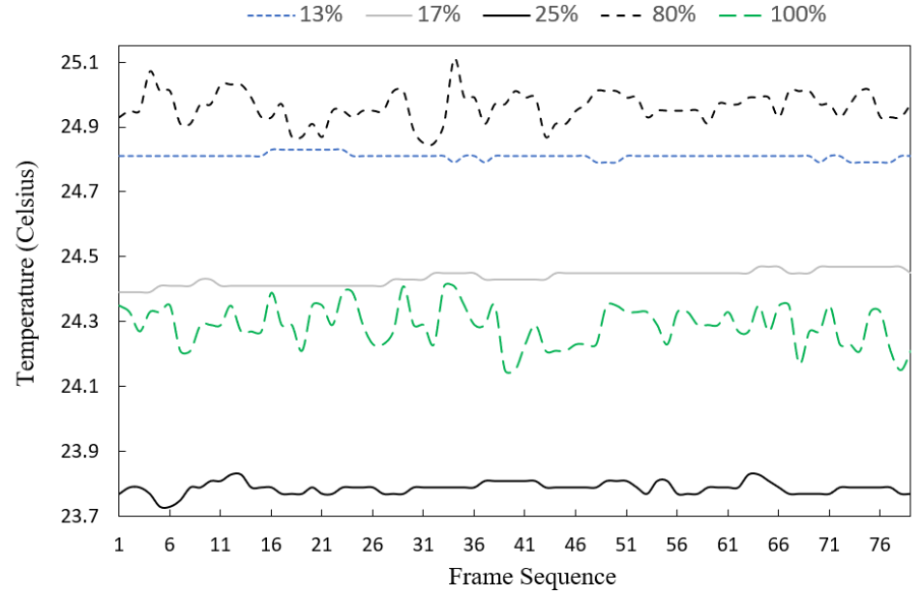
Temperature Sensor Refinements

Slide 13
Temperature Sensor Refinements (continued)
Only three IIR settings were chosen as the temperature levels were stable.
13%
17%
25%
We completed the calibration process by:
Exposing the temperature sensor
Black body with a low temperature (i.e., room temperature)
Heat source with a higher temperature

Slide 14
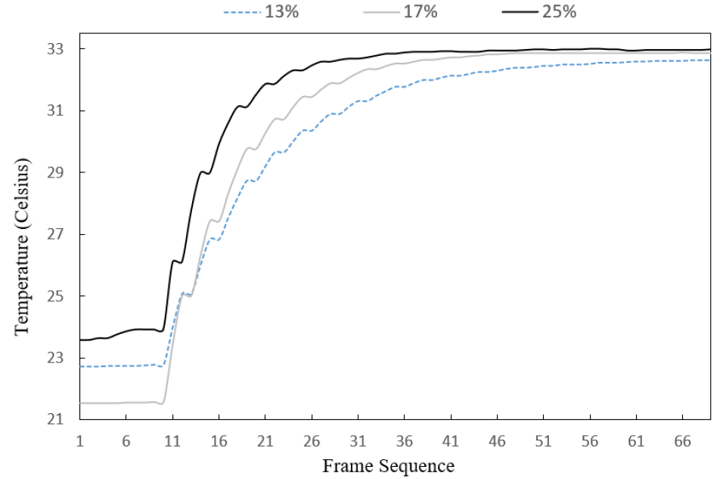
Temperature Sensor Refinements (continued)

Slide 15
Temperature Sensor Refinements (continued)
Based on the three percentages
IIR with 25% allowed the temperature sensor to have a faster stability for the temperature readings.
IIR with 25% needs a lower number of input frames.
This percentage balances between the speed of the filtered temperature readings and the noise levels.
The Emissivity coefficient (E) was set to 95%.
Based on the comparison with PC828 thermometer readings (FDA and Health Canada approved device)

Slide 16
Methodology - SpO2/Pulse Rate Sensor Refinements
For the calibration process
We specified the sample size collected from MAX30101 to be at most fifty samples.
We selected three consecutive and equal SpO2 and PR measurements.
The confidence level was specified to be at least 99%.
After this criterion was satisfied, the measurements were averaged.

Slide 17
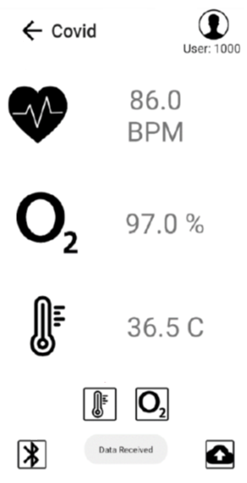
A New COVID-19 Mobile Application
A user-friendly Android application was designed and developed to trigger the capturing process for the following:
SpO2
Pulse Rate (PR)
Temperature

Slide 18
Findings - Study Participants
Six participants were recruited to participate in our experiments and provided their consents.
The group of participants consisted of four males and two females.
The range of ages
The male group was between twelve years of age and sixty-five years of age.
The female group was between eighteen years of age and sixty-five.
The Research Ethics Board’s protocols of Sheridan College (SREB No 2018-12-001-035) were followed.

Slide 19
Findings - Measurement, Data Collection and Experiment Controls
The delivered kit consisted of the following components:
The new mHealth system
Gold standards approved by the FDA and Health Canada
CMS7000 PLUS patient monitor– Contec
PC828
The new mHealth system
Samsung Galaxy A01 Core
RF-star RF-BM-ND04 – based hub (Nordic nRF52832 chip) via Bluetooth 5
Melexis’ MLX90614 DCI and MAX30101 modules.

Slide 20
Findings - Measurement, Data Collection and Experiment Controls (continued)
Measurements
SpO2
Pulse Rate (PR)
Temperature
There were two types of trials:
Resting condition in the morning or at night (Group A)
After wall push-up exercise in the afternoon (Group B)
It was repeated until the participants felt that the intensity of the exercise was relatively hard.

Slide 21
Findings - Statistical Analysis
Inferential statistics were used to analyze the collected vitals with a 95% confidence level.
IBM®SPSS®.
The collected data was assumed to follow the normal distribution
Sample size for each participant for each type of measurements was equal to fifty samples.
Mixed-effect regression models were applied on each of the measured data (e.g., temperature).
Tested the difference in the rate of change for the measured data between the gold standard device and the new system.

Slide 22
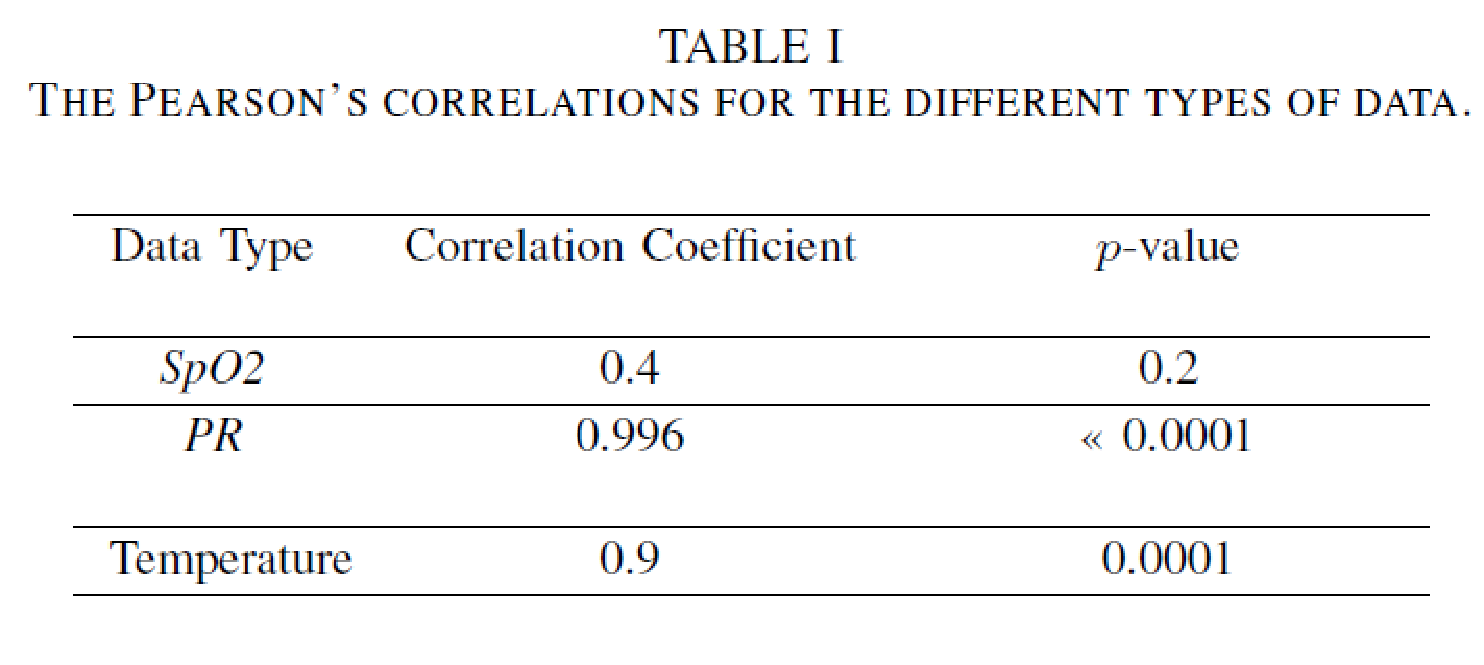
Findings - Oxygen Level, Pulse Rate and Temperature Analysis

Slide 23
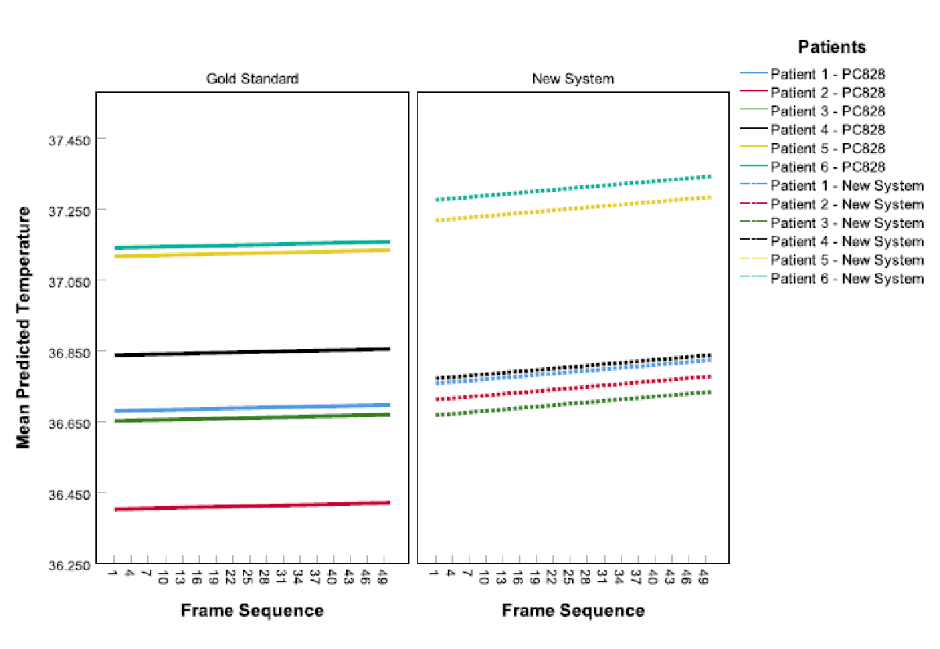
Findings - Mixed Model Regressions for the Temperature (Group 1)

Slide 24
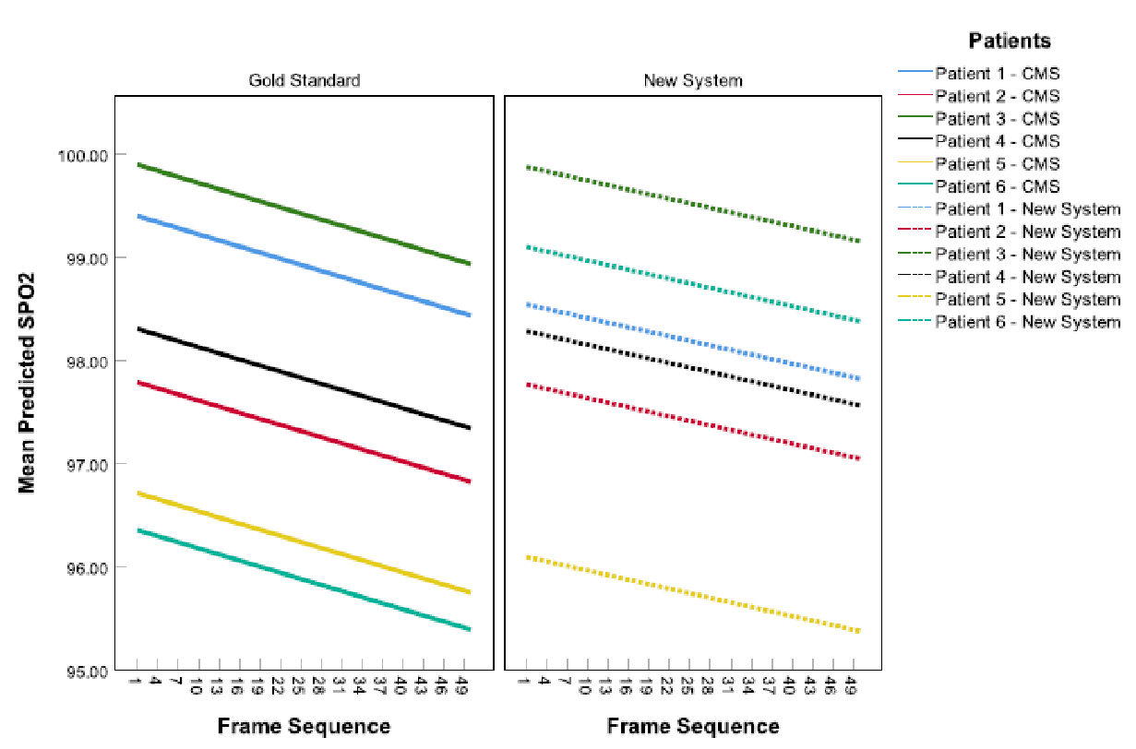
Mixed Model Regressions for the Oxygen Level (Group 2)

Slide 25
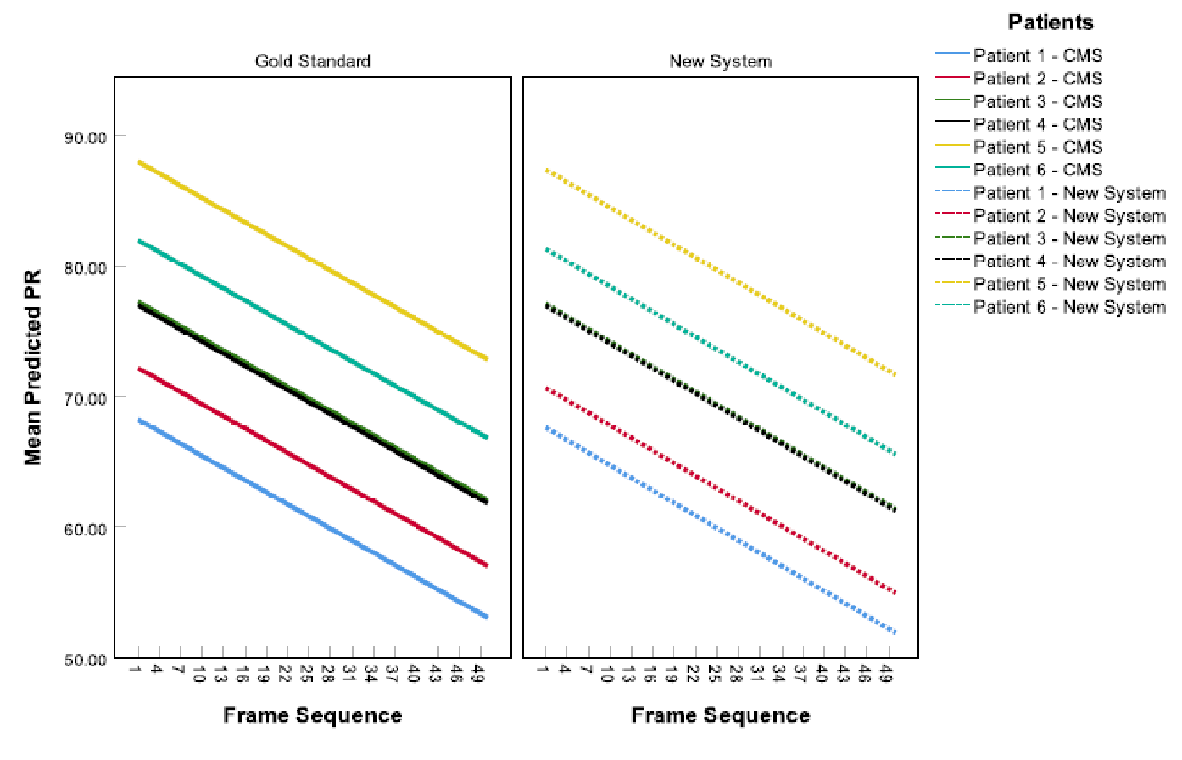
Mixed Model Regressions for the Pulse Rate (PR) (Group 2)

Slide 26
Conclusion
In this paper, a new and low-cost mobile Health (mHealth) system was designed and developed.
The new system consists of the followings:
Two refined biosensors
Temperature and peripheral hemoglobin oxygen saturation (SpO2) sensors
A new mobile application
The refinements were based on the calibration with the gold standard devices.

Slide 27
Conclusion (continued)
For the mobile app
It collects the data from those sensors via Bluetooth to display them on the screen.
It uploads them to a private cloud (i.e., HIPPA compliant server).
A real-world analysis was completed.
The relationship between the new and gold standard devices were strongly correlated.
Pulse rate (≈ 100%)
Temperature (≈ 90%)

Slide 28
Conclusion (continued)
A real-world analysis was completed.
The differences in the rate of change between the new and gold standard devices were mostly insignificant.
SpO2
Temperature
Pulse rate

Slide 29
Future Work
The sample size needs to be increased.
The sample should also include more age groups to further verify the accuracy of the new system.

Slide 30
Contact Info.
Dr. Tarek El Salti (he/him)
Professor, Applied Computing
Faculty of Applied Science and Technology (FAST)
Trafalgar Road Campus
1430 Trafalgar Road
Oakville, Ontario L6H 2L1
T 905 845 9430 Ext. 2950 E-mail: tarek.elsalti@sheridancollege.ca

Slide 31
References
World Health Organization’s (WHO) Global Health Estimates, "The top 10 causes of death", WHO. December 9, 2020. [Online]. Available: https://www.who.int/news-room/fact-sheets/detail/the-top-10-causesof-death, Accessed on: June 24, 2021.
W.-j. Guan, Z.-y. Ni, Y. Hu, et al., "Clinical Characteristics of Coronavirus Disease 2019 in China", New England Journal of Medicine, vol. 382, no. 18, pp. 1708-1720, 2020. Accessed on: June 25, 2021. [Online]. Available doi: 10.1056/NEJMoa2002032.
W. S. Lim, M. M. van der Eerden, R. Laing, W. G. Boersma, N. Karalus, G. I. Town, S. A. Lewis, and J. T. Macfarlane, "Defining community acquired pneumonia severity on presentation to hospital: an international derivation and validation study", Thorax, vol. 58, no. 5, pp. 377-382, 2003. Accessed on: June 25, 2021. [Online]. Available doi: 10.1136/thorax.58.5.377.
S. Mozgai, A. Hartholt and A. Rizzo, "The Passive Sensing Agent: A Multimodal Adaptive mHealth Application", IEEE International Conference on Pervasive Computing and Communications Workshops (PerCom Workshops), pp. 1-3, 2020. Accessed on: September 28, 2021. [Online]. doi: 10.1109/PerComWorkshops48775.2020.9156177.
M. N. Islam, I. Islam, K. M. Munim and A. K. M. N. Islam, "A Review on the Mobile Applications Developed for COVID-19: An Exploratory Analysis", in IEEE Access, vol. 8, pp. 145601-145610, 2020. [Online]. doi: 10.1109/ACCESS.2020.3015102.
D. Kotz, "Amulet: an open-source wrist-worn platform for mHealth research and education", the 11th International Conference on Communication Systems & Networks (COMSNETS), pp. 891-897, 2019. [Online]. Available: doi: 10.1109/COMSNETS.2019.8711407.
Mrinai M. Dhanvijay, Shailaja C. Patil, "Internet of Things: A survey of enabling technologies in healthcare and its applications", Computer Networks, vol. 153, pp. 113-131, 2019. Accessed on: September 24, 2021. [Online]. Available: doi: https://doi.org/10.1016/j.comnet.2019.03.006.
C. P. Adans-Dester et al., "Can mHealth Technology Help Mitigate the Effects of the COVID-19 Pandemic?", IEEE Open Journal of Engineering in Medicine and Biology, vol. 1, pp. 243-248, 2020. Accessed on: June 24, 2021. [Online]. Available: doi: 10.1109/OJEMB.2020.3015141.
"Apple Watch Series 6". Accessed on: June 24, 2021. [Online]. Available: https://www.apple.com/apple-watch-series-6/

