Slide 2
Experiential Learning Insights Brought into the PSB Classroom
Draws upon the Building Small Business Resilience Applied Teaching research project and its incorporation into the Sheridan Pilon School of Business courses.

Slide 3
AGENDA
Presentation Summary Blog
1. Why Experiential Learning?
2. What is the Research?
3. Experiential Learning Insights
4. Comments, Collaborations, Questions
https://digitalmarketingresearch.ca/ten-experiential-learning-insights-bsbr-analysis-1/

Slide 4
WHY EXPERIENTIAL LEARNING?
So Students Can Get Jobs When They Graduate!

Slide 5
Learning by doing
Hands-on experiences
Better connection of theories to workable knowledge
Applying classroom learning to real-world situations
In summary…."Just really Do It!"
Experiential Learning

Slide 6
EDUCATION IS IN CRISIS! WE HAVE TO LEAVE OUR BUBBLE
The Problem!
https://www.managers.org.uk/wp-content/uploads/2021/09/employability-skills-research_work-ready-graduates.pdf
Notes:
https://www.managers.org.uk/wp-content/uploads/2021/09/employability-skills-research_work-ready-graduates.pdf

Slide 7
WHY EXPERIENTIAL LEARNING?
Key report findings:
Half of graduates (50 percent) didn’t apply to entry-level jobs because they felt underqualified
One in five (21 percent) say their college didn’t provide them with needed job skills; nearly two in five (38 percent) occasionally or rarely use the skills they learned
29 percent of all graduates spent more than six months trying to find a job after graduation
Nearly half of graduates don’t believe their education was worth what they paid, and one in three don’t believe their education helped them land their job
https://cengage.widen.net/content/e5oqtwwrw1/pdf/Graduate_Employability_Report---May-24-FINAL.pdf
Notes:
https://cengage.widen.net/content/e5oqtwwrw1/pdf/Graduate_Employability_Report---May-24-FINAL.pdf?u=fn2gt2

Slide 8
STUDENTS LOVE EXPERIENTIAL LEARNING! COMMENTS SAMPLE…
"Out of all the courses I've taken at Sheridan, I would say that this course has honestly taught me the most. Majority of the courses provided at Sheridan are theory based which majority of people end up forgetting at some point. I've always believed you learn more and remember more when doing, and this course has done exactly that. I've learned skills and concepts that will be extremely useful and valuable in my career. I also came out from the course with actual portfolio items which is amazing."
"This class was absolutely amazing and in my honest opinion it was nearly flawless. I would love to take more classes like this as a marketing student."
"The course is just very fun and interactive. I learned A LOT. I was able to make Ads i never thought i could! It was truly the MARKETING experience that every student should have. I believe it is essential because Students who take this course, will understand what marketing is all about. It's a great course."
"This course has helped me a lot and I found it very practical which should help me be more prepared in the future."
"I wanted to let you know that your class was very engaging, well balanced, and full of useful tips and information. I am confident to say that this class was one of the best classes I have ever taken."

Slide 9
WHAT IS THE RESEARCH?
Multi-Year Applied Digital Marketing Research Project

Slide 10
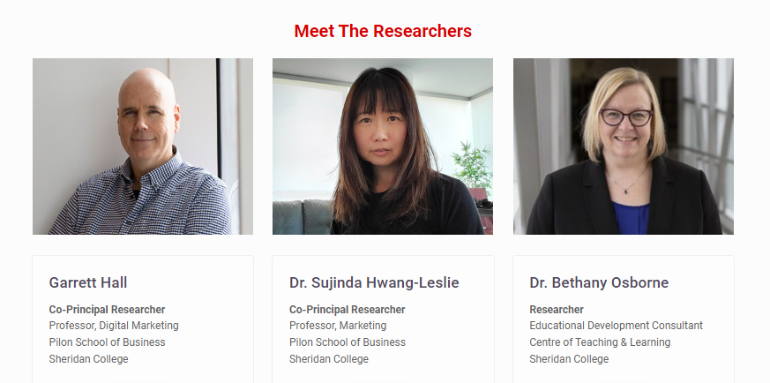
THE RESEARCHERS

Slide 11
DIRECT MARKETING RESEARCH PROJECT
BUILDING SMALL BUSINESS RESILIENCE (BSBR)
BSBR Digital Marketing Training Program has been financed by Sheridan Pilon School of Business (PSB) and funded by the Government of Canada Future Skills Centre to aid underrepresented small business owners that were affected by the COVID-19 crisis. Sheridan EDGE center has supported business recruitment and administration of the project.
It was a free 12-week training program run two times to help support small businesses with their digital marketing to recover from the economic crisis brought about by COVID-19.

Slide 12
THE PARTICIPANTS
229+ Entry Applications
https://digitalmarketingresearch.ca/free-digital-marketing-training-course-for-small-business-owners/
52+ Course Participants
Alpha Course 1st Cohort (Fall 2021)
https://digitalmarketingresearch.ca/bsbr-report-stage-1-program-design/
19 Participants Selected
Beta Course 2nd Cohort (Winter 2022)
33 Participants Selected

Slide 13
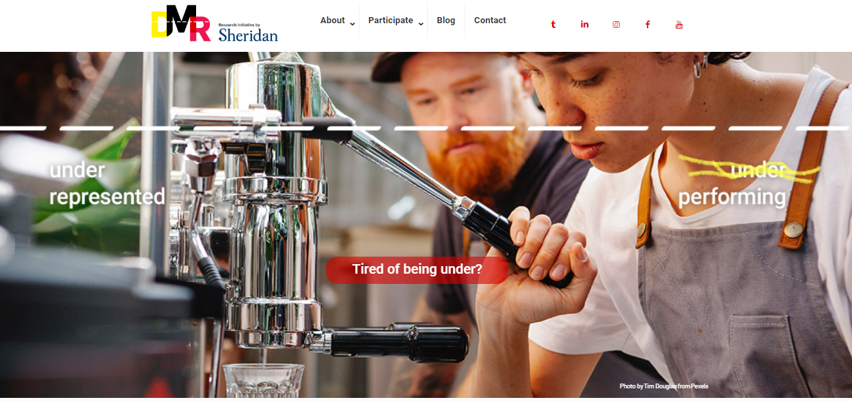
THE RESEARCH
https://digitalmarketingresearch.ca/
Notes:
https://digitalmarketingresearch.ca/

Slide 14
TWO FUNDAMENTAL RESEARCH QUESTIONS
Q1: Curriculum design and training methodology. Applied course design for adult learners; adapting learning materials and teaching styles from the classroom to adult education and taking insights back to the classroom.
Looking at the course build through an academic teaching lens.
Q2: Effectiveness of the training course for business digital marketing performance. Looking at tangible business outcomes including ROI, revenue and profit, digital performance (audience reach and engagement).
How well the digital marketing training works in terms of the business success.
Discussed today!

Slide 15
INFORMATION TO ANSWER THE TWO QUESTIONS
In Depth Personal, Business & Digital Marketing Metrics
Digital Marketing & Business Outcome Metrics
1) Prescreen Entry Metrics
2) 6 Months After Course Metrics
3) 6 Months After Course Focus Group
4)12 Months After Course Metrics
5) 12 Months After Course Focus Group
Course Methodology Evaluation
Course Content & Structure Feedback
1) Precourse Focus Group
https://digitalmarketingresearch.ca/bsbr-research-stage-2-program-development/
2) 4 Week Course Survey
3) 8 Week Course Survey
4) 12 Week Course Survey
5) Course End Focus Group
* Also ongoing individual exploratory discussion through out.
Discussed today!

Slide 16
EXPERIENTIAL LEARNING INSIGHTS
What did we learn?

Slide 17
EXPERIENTIAL LEARNING IN THE CLASSROOM
Built into the research has been testing of existing PSB Digital Marketing digital marketing course theory and applied tactics.
Then throughout the training course we gathered insights to circle back with recommendations to further develop the PSB Digital Marketing courses.
https://digitalmarketingresearch.ca/ten-experiential-learning-insights-bsbr-analysis-1/
Notes:
https://digitalmarketingresearch.ca/ten-experiential-learning-insights-bsbr-analysis-1/

Slide 18
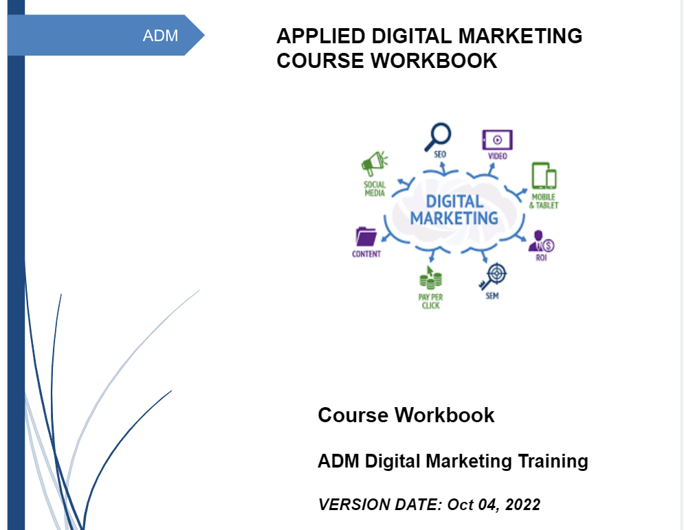
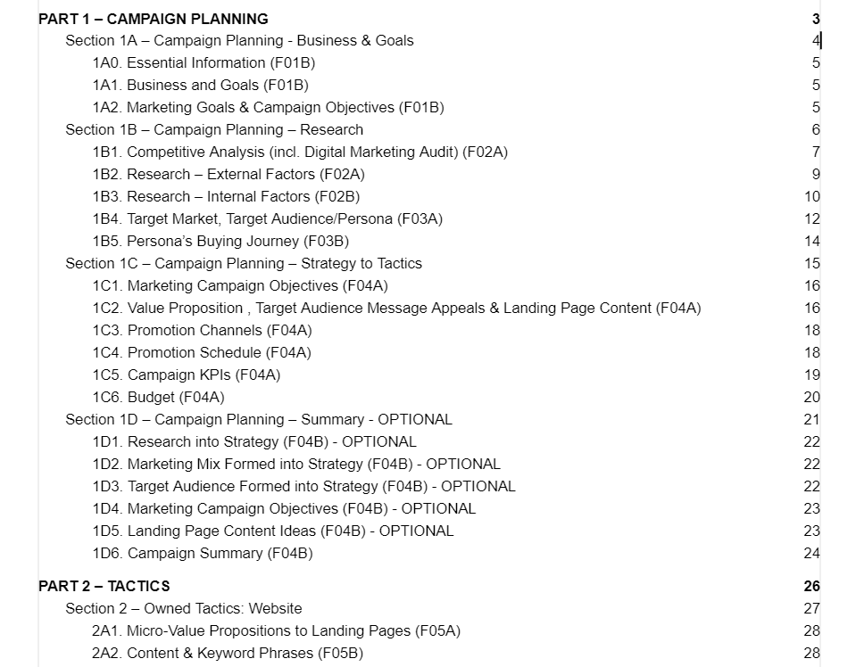
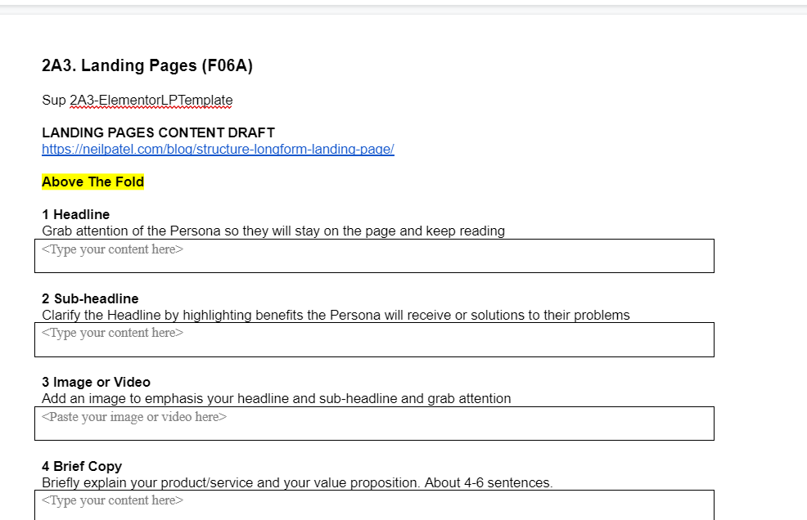
THE COURSE WORKBOOK
GUIDED CONTROL
All-In on Backward Design
The course has a workbook that guides the students in a linear fashion of A to Z.
All lessons and resources directly follow and support undertaking the the document.
Notes:
https://docs.google.com/document/d/1fxjIlvXflUxMaDVxPHyaABrJ3vaEqfOzeE7tyMMchcE/edit?usp=sharing

Slide 19
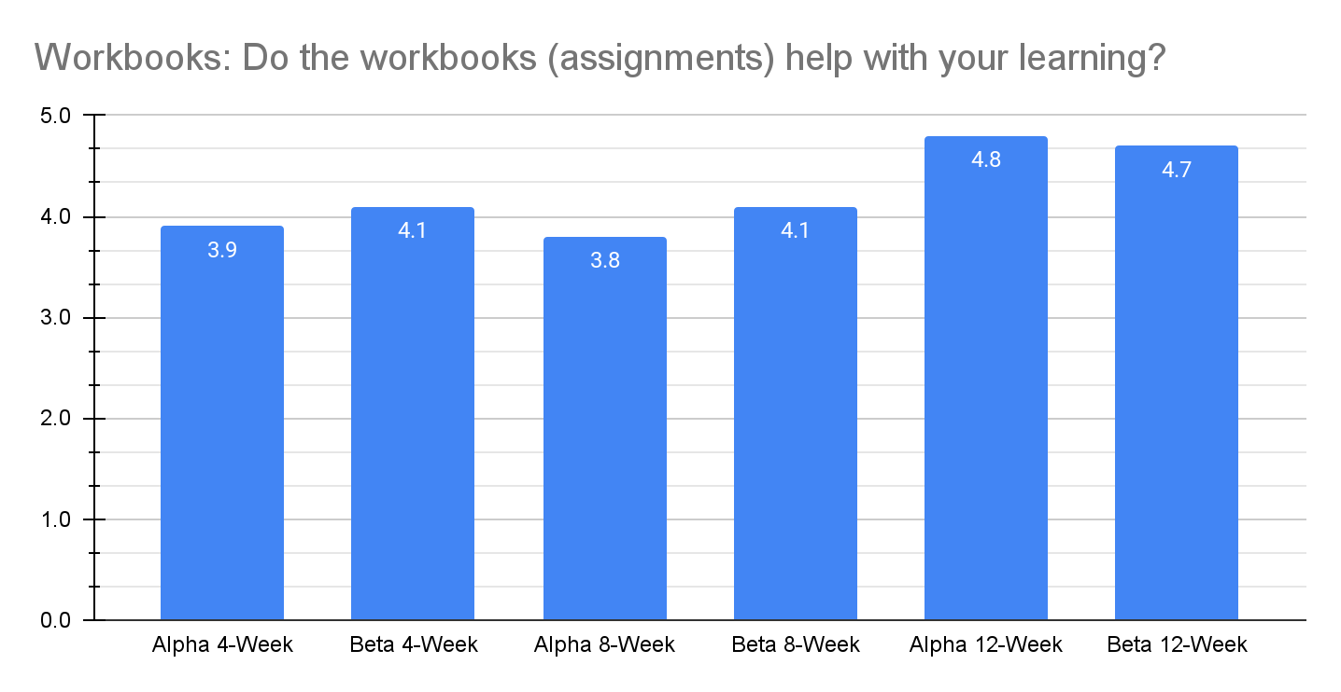
"The workbook is a masterpiece"
4.0 -> 4.0 -> 4.8 out of 5 They loved the guided workbook. Backward Designed.
Notes:
If there is one thing to take away from this presentation….this is it.
Take away - turn your course linear and guided. Lessons directly support the assignments.

Slide 20
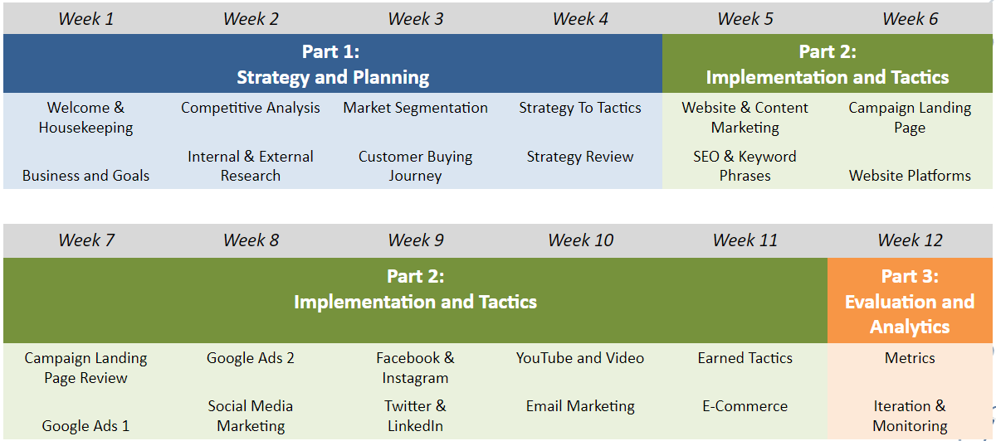
THE COURSE CONTENT
The 12-week course was created in part using material from our two owned-organic/earned and paid Sheridan courses.
The course content was designed to follow an end-to-end workbook that would be used to guide the businesses and supporting student through the client digital marketing. The course elements are shown in this chart.

Slide 21
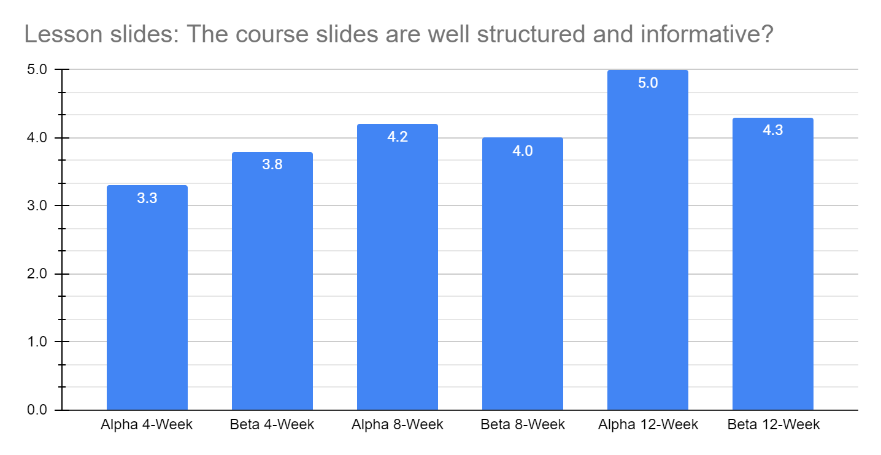
"All content is there so easy to use for reference; thorough and supports the lesson well."
3.6 -> 4.1 -> 4.7 out of 5 Problems with strategy, loved the tactics.
Notes:
For real world business owners, the foundational aspects of digital marketing were frowned upon. And in some cases outright anger!
Take away - ensure you match up theory with the tactics. Show the line.

Slide 22
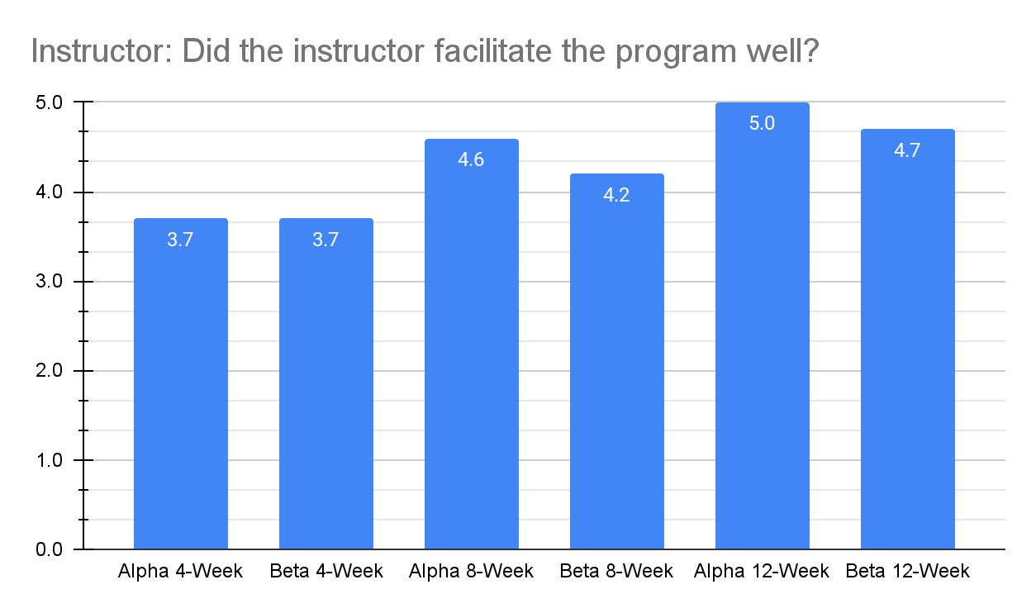
"A wonderful balance between sharing his own insights directly and answering questions in a way that was helpful to everyone."
3.7 -> 4.4 -> 4.9 out of 5 50% Content / 50% Teaching Style
Notes:
As the content was proven and shifted to what they felt the course should be, I was rewarded.
Take away - Content as they see it and your teaching style are a duo of success. You need to sell it.

Slide 23
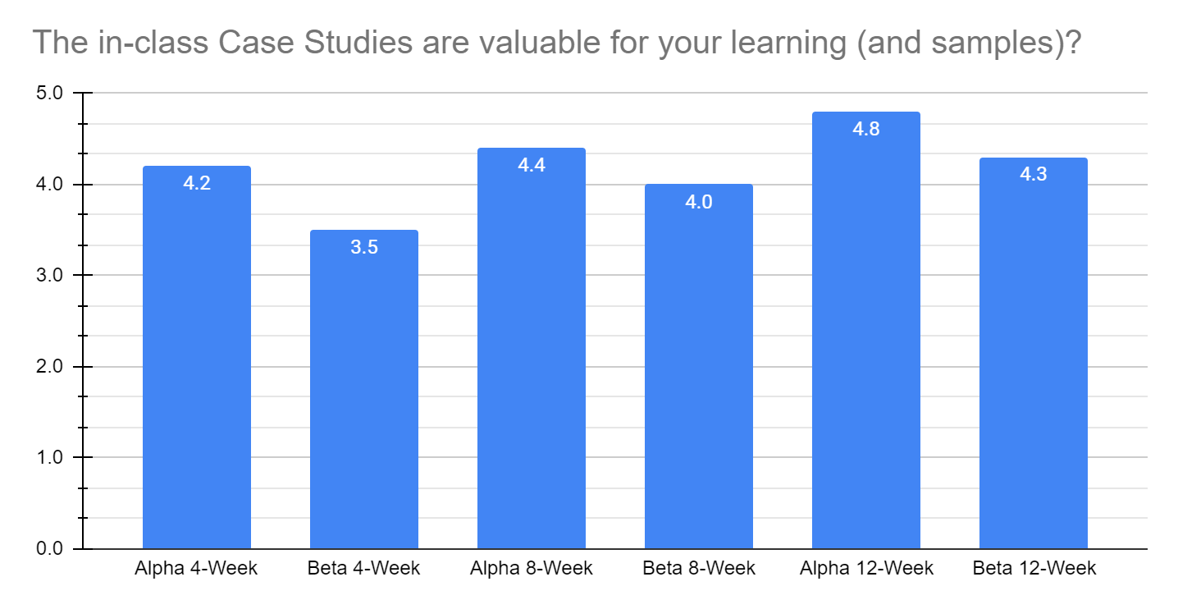
"I would love to see more things built from scratch like a Google Ad"
3.9 -> 4.2 -> 4.6 out of 5 Wanted examples and cases specific to their needs.
Notes:
Take away - they want what they want. Individualized is gold to the student.

Slide 24
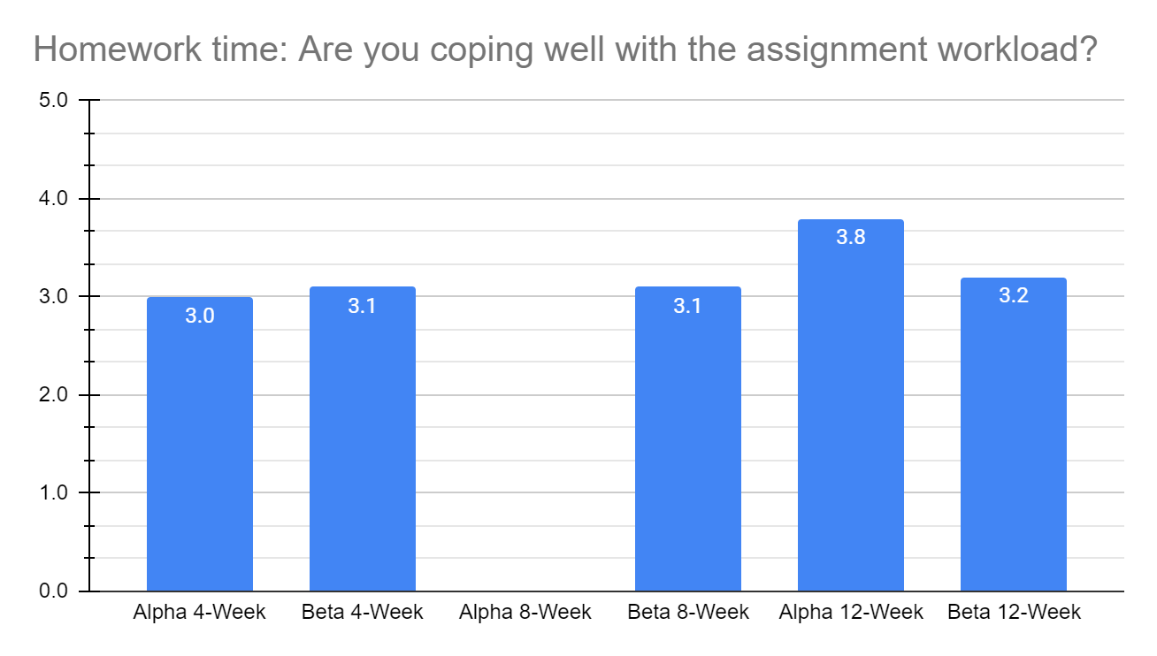
"Too much work in little time with staffing problems in the business."
3.1 -> 3.1 -> 3.5 out of 5 They were overwhelmed with their business and the course.
Notes:
Take away - ensure you have the right time period for the instruction and assignments.

Slide 25
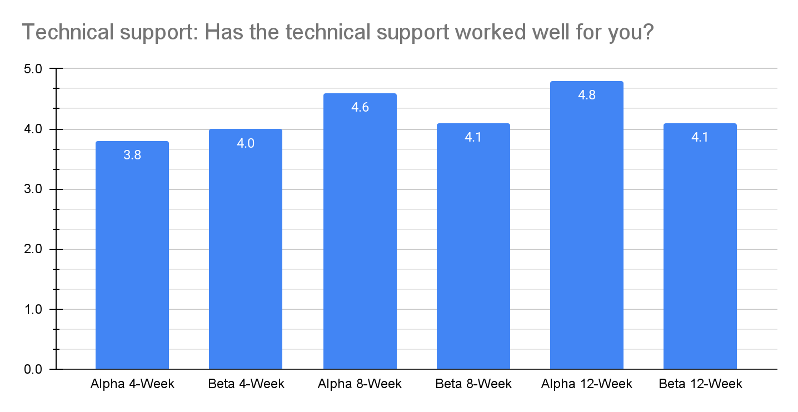
"Still had to reach out for additional support as issues were discovered on my end."
3.9 -> 4.4 -> 4.6 out of 5 Liked the one-on-one support.
Notes:
Take away - Tech is a part of some courses. Also, again, they want what they want. Individualized.

Slide 26
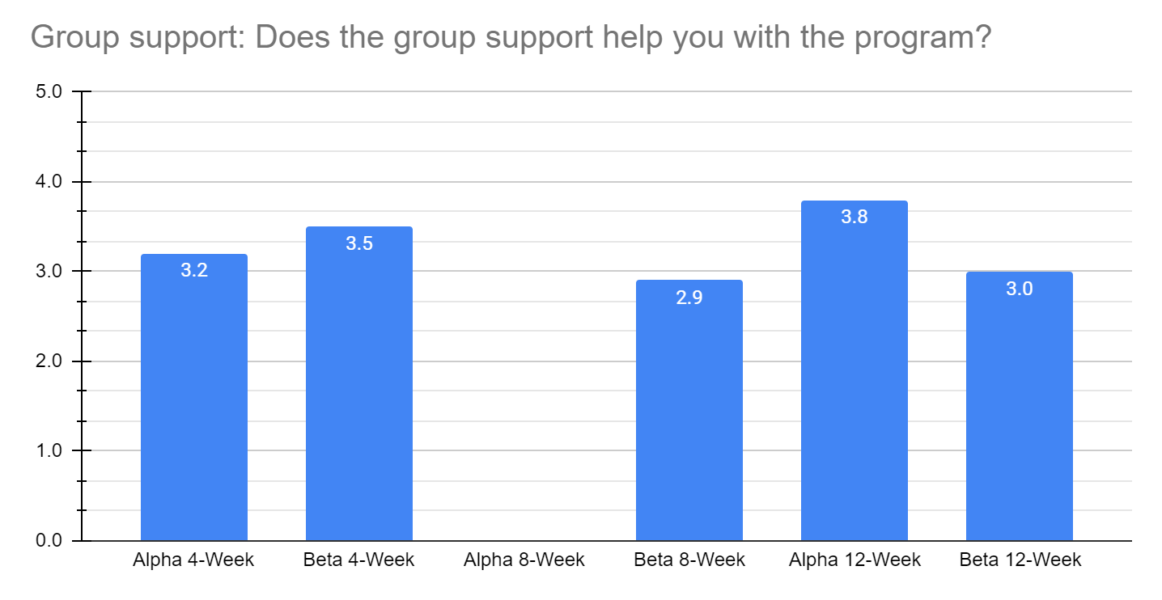
"An experienced Team Captain would be cool. Some strong personalities in the group that can take up a lot of air and be a bit distracting sometimes."
3.4 -> 2.9 -> 3.4 out of 5 We did not figure out how to work this.
Notes:
Take away - they cannot just “run” with their groups.

Slide 27
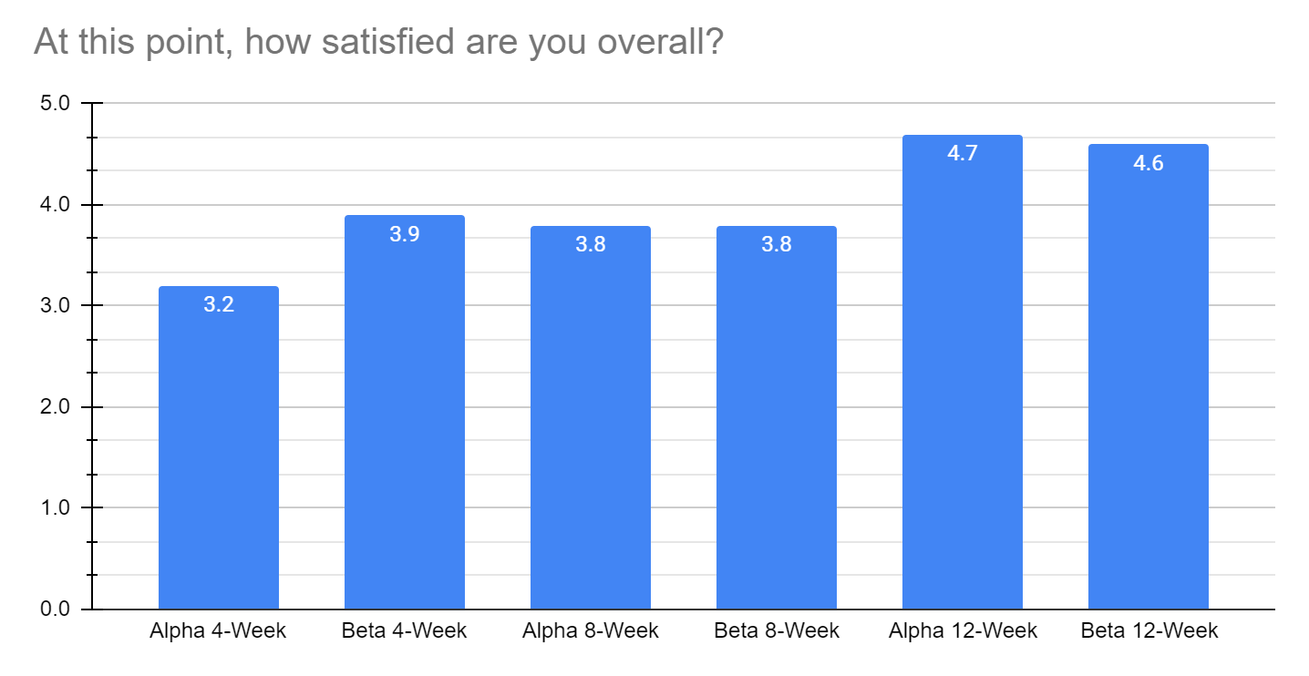
"A straightforward and comprehensive guide to everything you need to know for digital marketing. I am forever grateful."
3.6 -> 3.8 -> 4.7 out of 5 As the course progressed satisfaction increased.
Notes:
Take away - you might be a bit like a doctor, creating pain to eventually heal the patient.

Slide 28
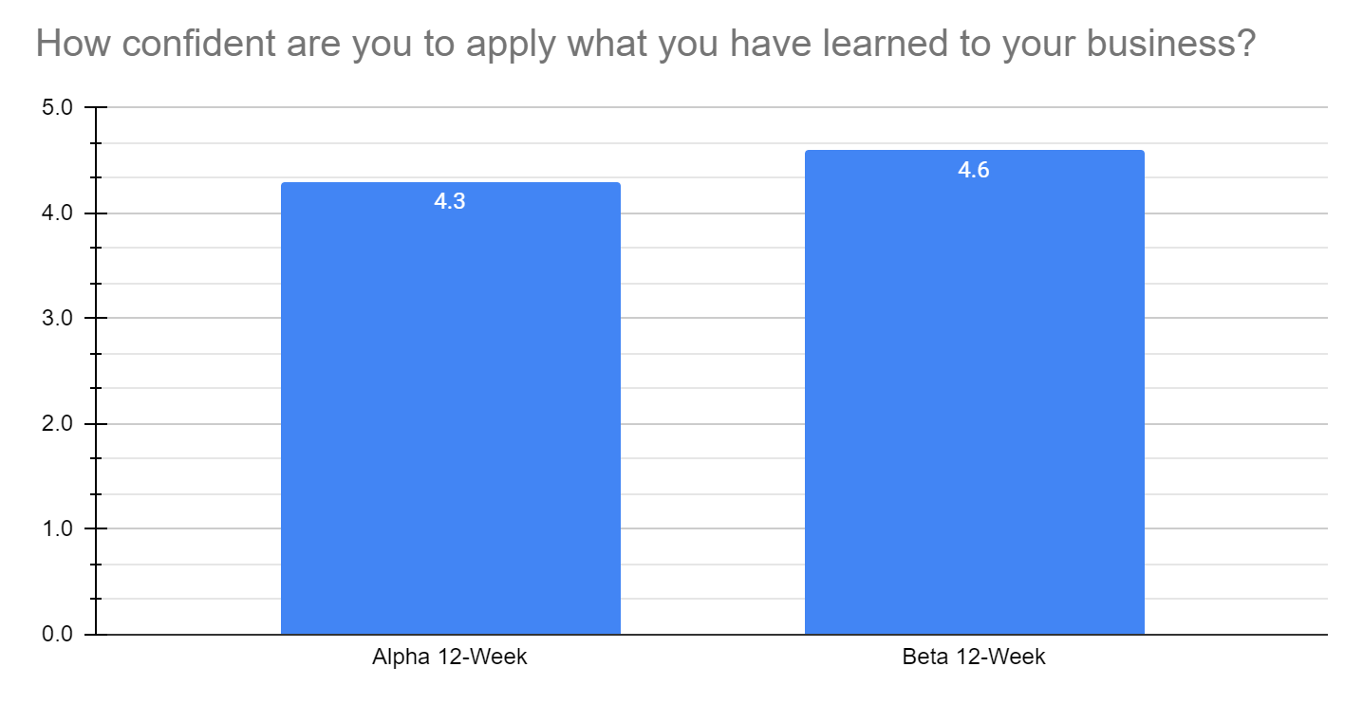
4.5 out of 5 Given the width breadth and speed of this course, this is outstanding.
Notes:
Take away - Applied gives confidence. The Google Ads example.

Slide 29
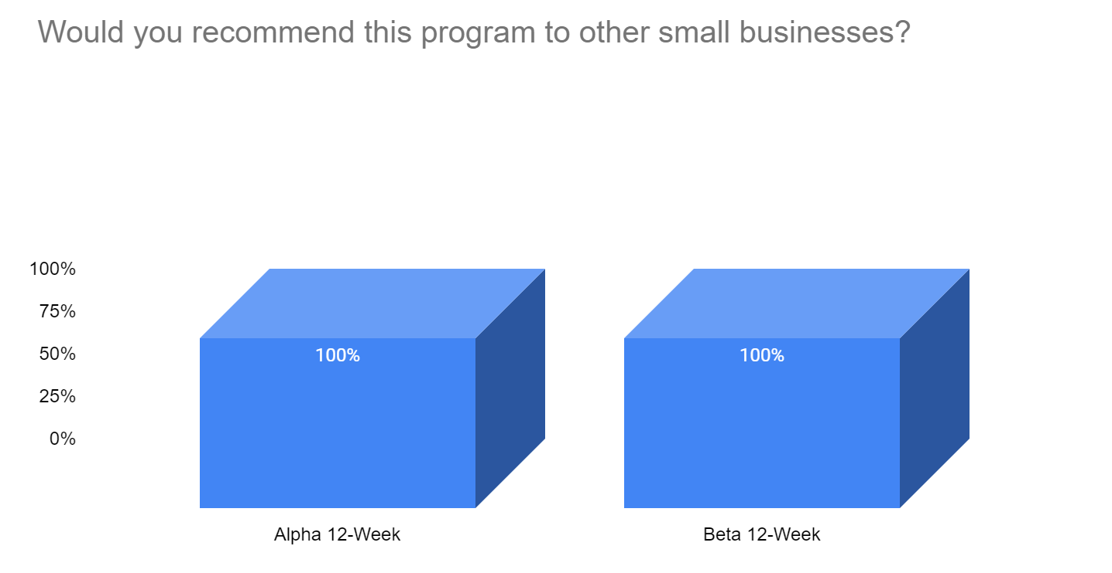
Yes - 100% What more needs to be said?
Notes:
Take away - lovely.

Slide 30
INFORMATION TO ANSWER THE TWO QUESTIONS
In Depth Personal, Business & Digital Marketing Metrics
Digital Marketing & Business Outcome Metrics
1) Prescreen Entry Metrics
2) 6 Months After Course Metrics
3) 6 Months After Course Focus Group
4)12 Months After Course Metrics
5) 12 Months After Course Focus Group
Course Evaluation
Course Content & Structure Feedback
1) Precourse Focus Group
https://digitalmarketingresearch.ca/bsbr-research-stage-2-program-development/
2) 4 Week Course Survey
3) 8 Week Course Survey
4) 12 Week Course Survey
5) Course End Focus Group
* Also ongoing individual exploratory discussion through out.
Discussed today! Watch the website for our next analysis on other data.

Slide 31
SUMMARY OF TODAY'S DISCUSSION
https://digitalmarketingresearch.ca/ten-experiential-learning-insights-bsbr-analysis-1/

Slide 32
THANK YOU!
Comments, Collaborations, Questions?

