Slide 1
SHERIDAN’S CENTRE FOR ADVANCED MANUFACTURING AND DESIGN TECHNOLOGIES

Slide 2
About CAMDT
CAMDT is an advanced technology hub where students, faculty, technical experts, and industry partners come together to learn, apply collaborate and innovate.
DESIGN
AUTOMATION
ADDITIVE MANUFACTURING
DIGITAL FABRICATION
SIMULATION AND MODELING
camdt.sheridancollege.ca

Slide 3
SHOWCASE
Notes:
Now we’d like to showcase two successful projects that we completed last year

Slide 4
CleanAir.AI ALVI PROJECT
CleanAir.AI is embarking on a product development mission to change the way we think about air quality. They are developing the world's smartest air filter for residential and commercial buildings.
Notes:
About ESR and project

Slide 5
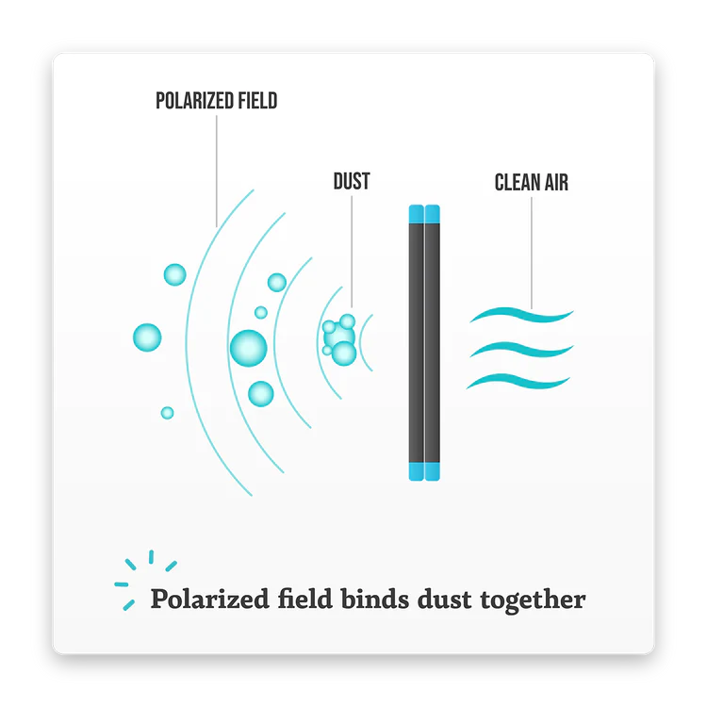
CleanAir.AI ALVI PROJECT
CleanAir.AI and CAMDT team are engaged in collaborative applied research to further the development of an advanced air filter, called ALVI. ALVI provides its users with cleaner air more efficiently while keeping them connected and informed about the air that they are breathing.
Notes:
About ESR and project

Slide 6
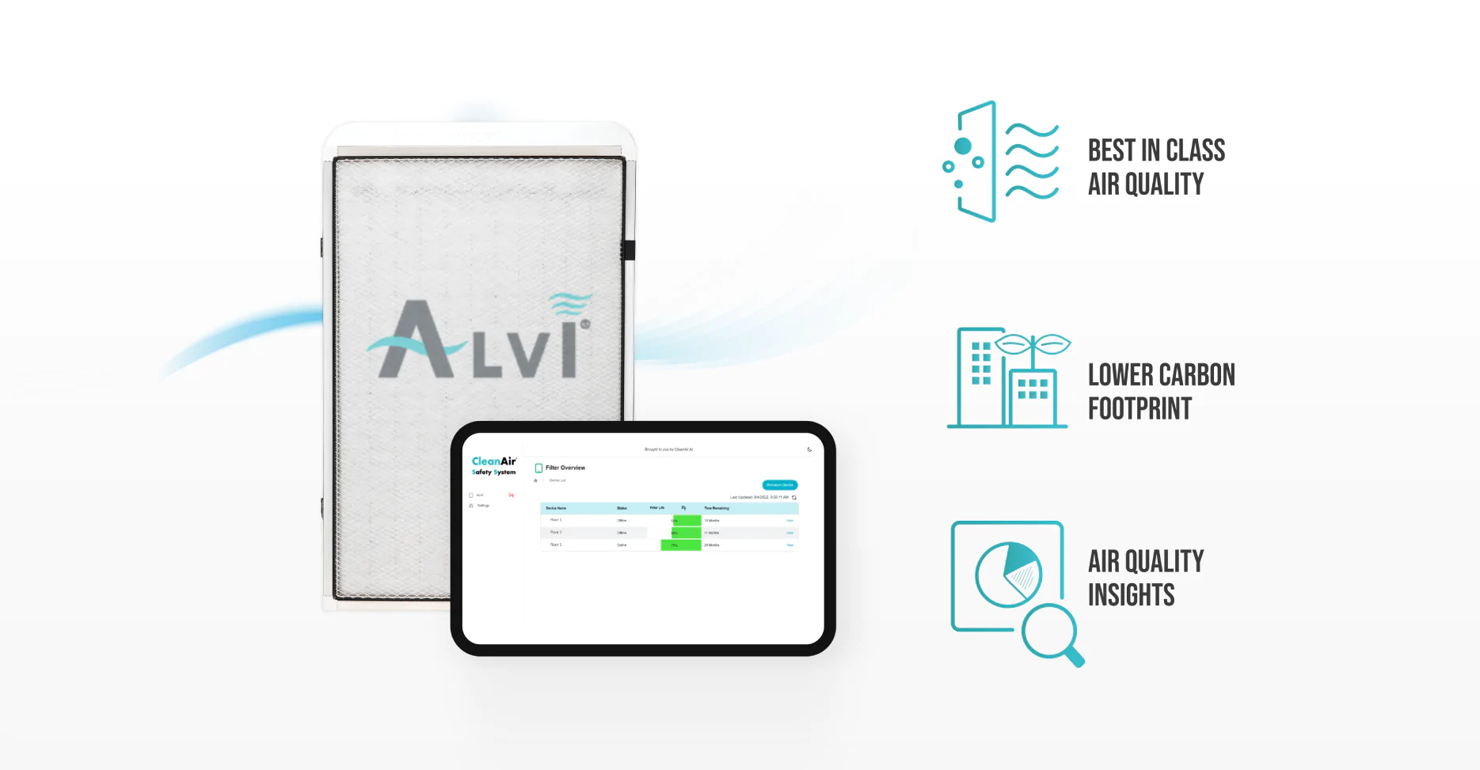
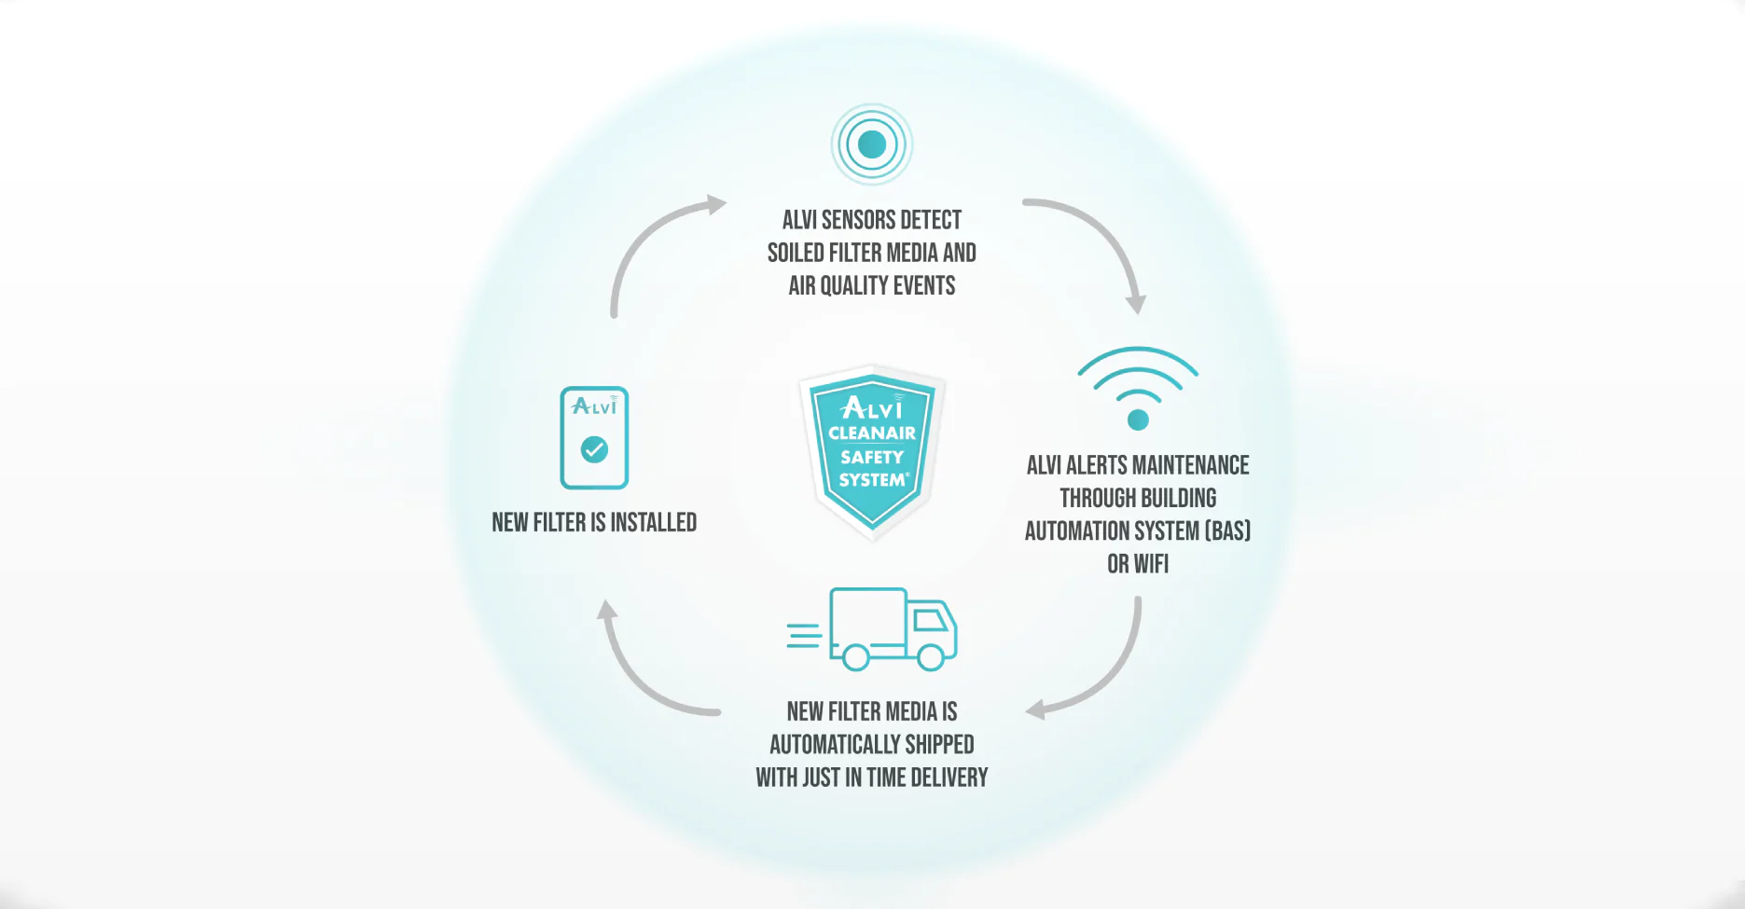
ALVI CleanAir Safety System
Notes:
About the project and why ESR came to Sheridan

Slide 7
CleanAir.AI – CAMDT
Hardware Prototyping
App Development
System Integration & Testing
Notes:
About the project and why ESR came to Sheridan

Slide 8
EAT SLEEP RIDE PROJECT
EatSleepRIDE.com (ESR) is a new breed of motorcycle community. Combining the best of today's social web with useful features tailored to motorcycle enthusiasts of all types, ESR is an open platform for the exchange of everything motorcycle.
Notes:
About ESR and project

Slide 9
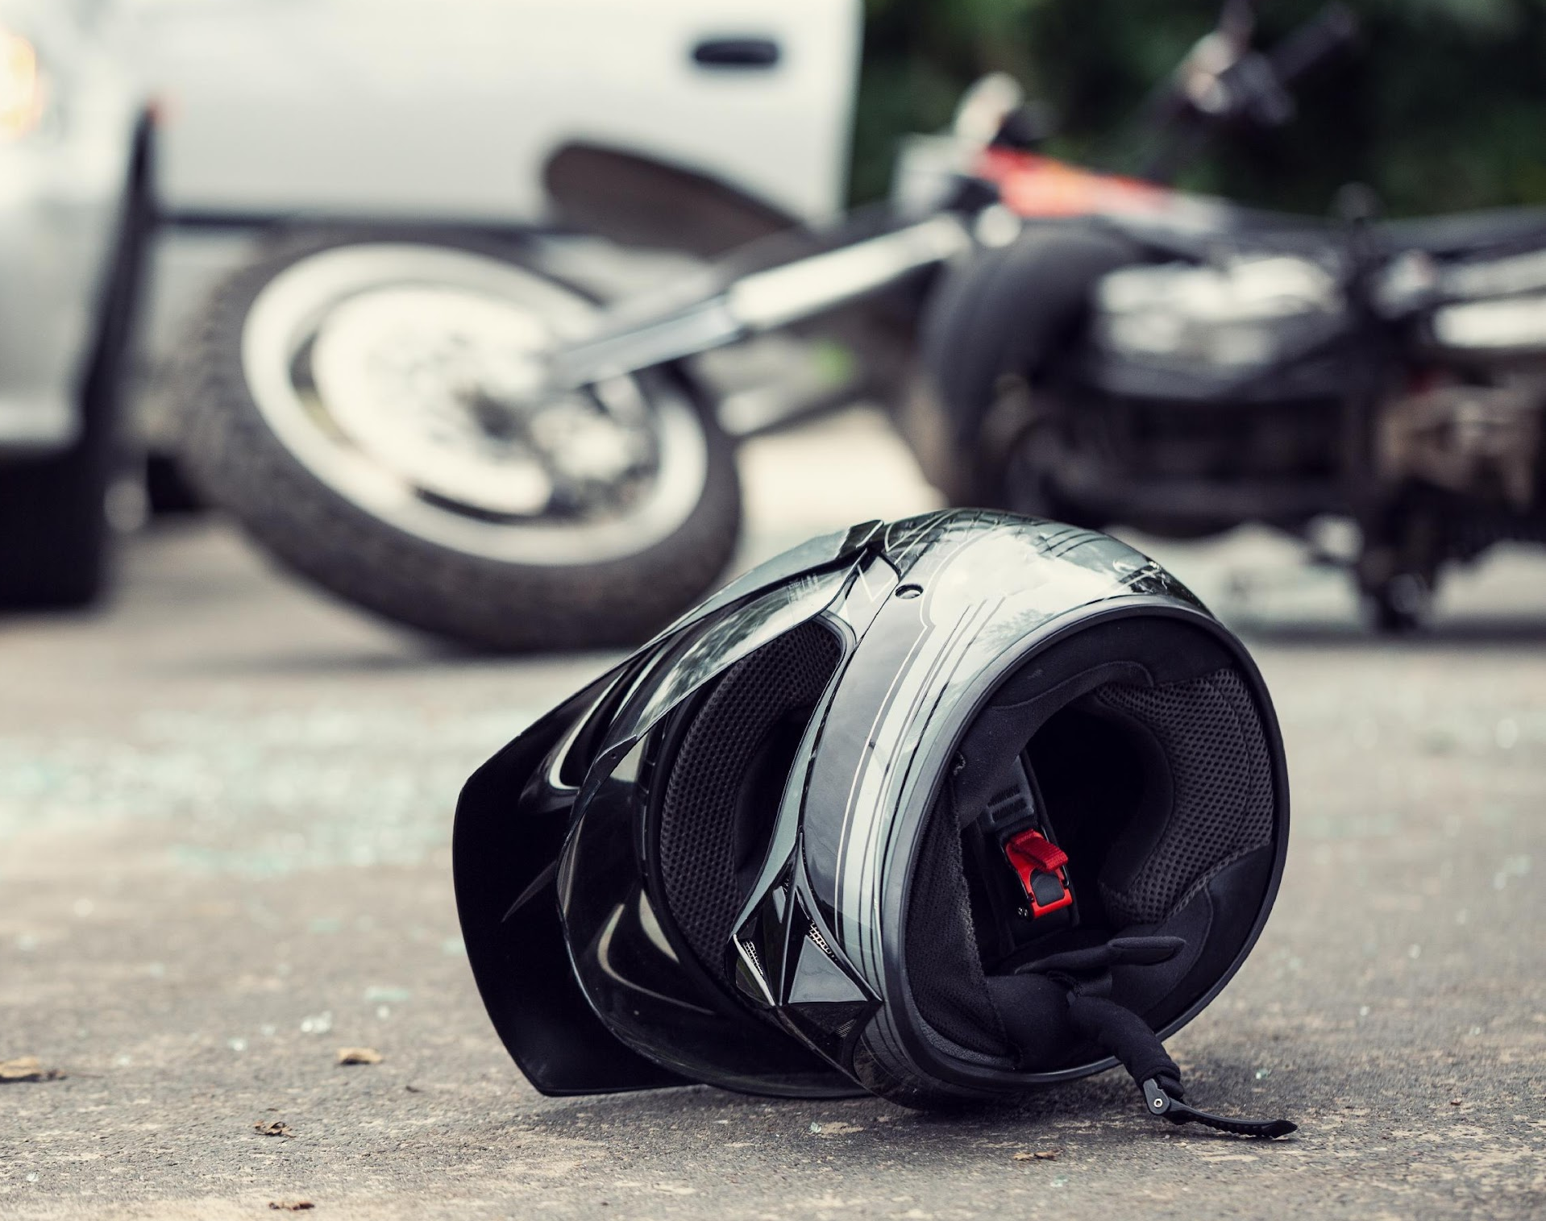
ESR – CAMDT
Crash detection algorithm
Testing multiple phone manufacturers
Consistent movement
Notes:
About the project and why ESR came to Sheridan

Slide 10
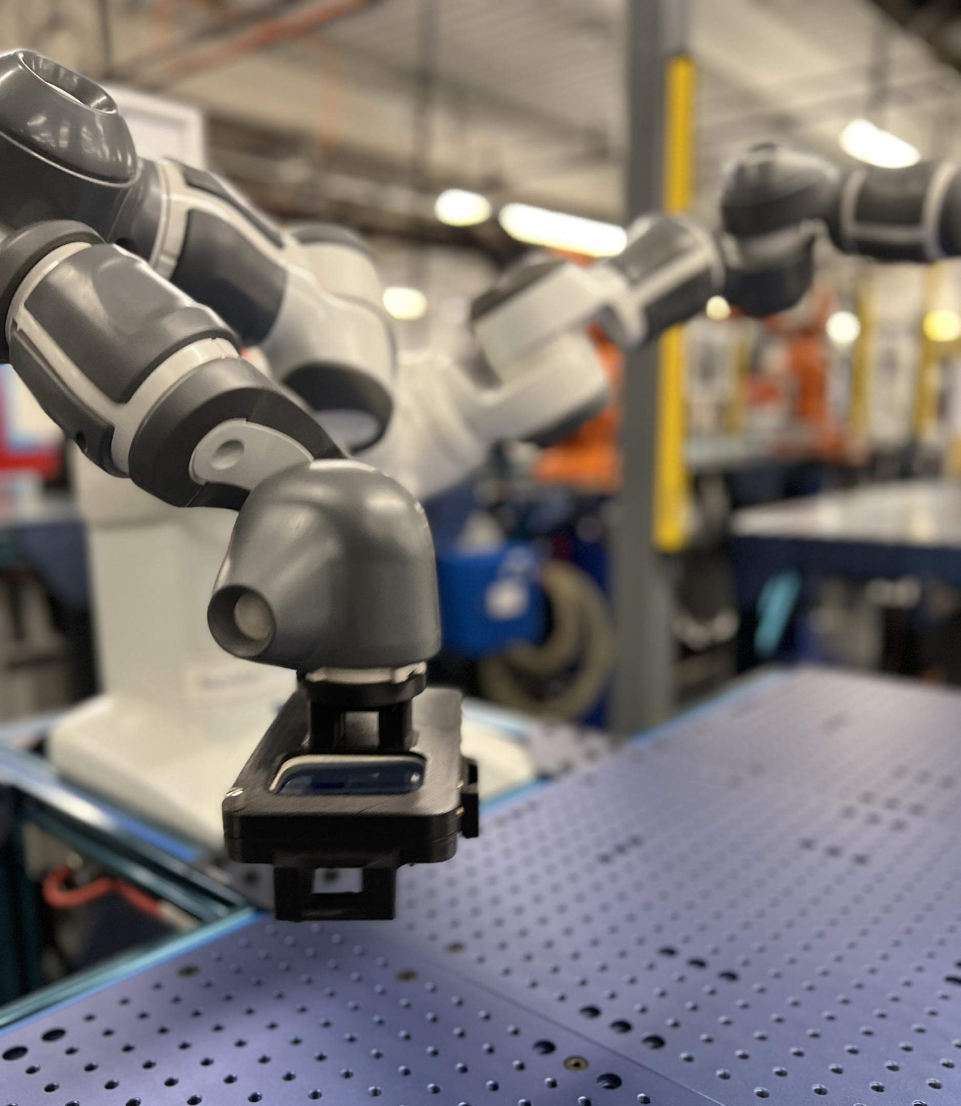
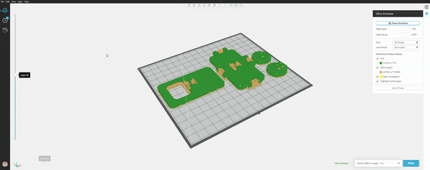
ENCLOSURE DESIGN FOR ROBOTIC ARM

Slide 11
Testing & data collection

