Slide 1
Find Collaborators. Be Discovered!
Faculty180 for Research, Innovation, and Entrepreneurship (RIE)
Cheryle Moreau​
Assistant to the​ Vice Provost, Research​
cheryle.moreau@sheridancollege.ca​

Slide 2
What is Faculty180 and Why Should I Use It?
VIDEO: Welcome to Faculty180 (1m33s)​
Find all updated Faculty180 Training videos at: https://sheridanc.sharepoint.com/sites/Faculty180-grp297-grp/Training%20Videos/Forms/AllItems.aspx

Slide 3
What are the key benefits?
Faculty180 acts as a single location for information and provides ease and convenience with many benefits including:
Showcasing your Research, Innovation and Entrepreneurship (RIE) activities and professional achievements through a faculty profile
Enabling you to find Sheridan colleagues with similar interests (internal through Faculty180 capabilities and the Sheridan Website)
Helping potential external collaborators find you (Sheridan Website faculty profile)
Generating custom CVs for grant applications or other purposes
Streamlining the Postsecondary Education Quality Assessment Board (PEQAB) program review process

Slide 4
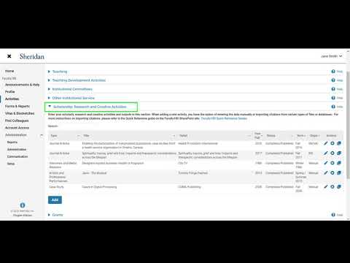
How do I get started?
VIDEO: Faculty180 Quick Walkthrough (3m56s)
Login to Faculty180
Profile (0:29s)
Activities (1m:01s)
Vitas & Biosketches (2m:05s)
Find Colleagues (2m:43s)
Find all updated Faculty180 Training videos at: https://sheridanc.sharepoint.com/sites/Faculty180-grp297-grp/Training%20Videos/Forms/AllItems.aspx

Slide 5
Synchronizing to your web profile
VIDEO: Sheridan Website Profile (2m58s)
These parts of the Faculty180 profile will be public:​
Full Name, Photo ​
Current Position​
Biography​
Teaching and Research Interests​
Scholarship, Research and Creative Activities*​
Grants*
*You have the option to choose which SRCA and grant records, if any, you want to display on the external website. ​

Slide 6
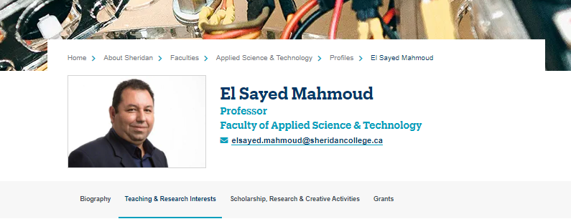
Sample web profile
What does a user profile look like on the Sheridan website?

Slide 7
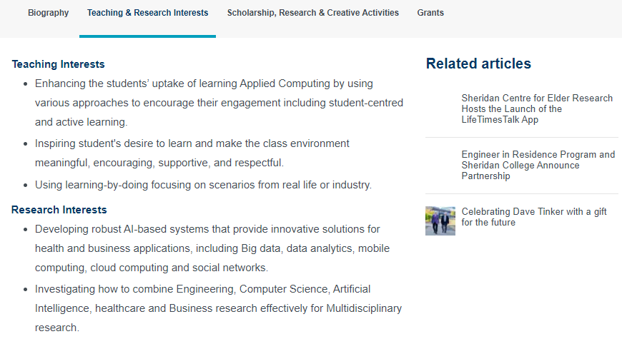
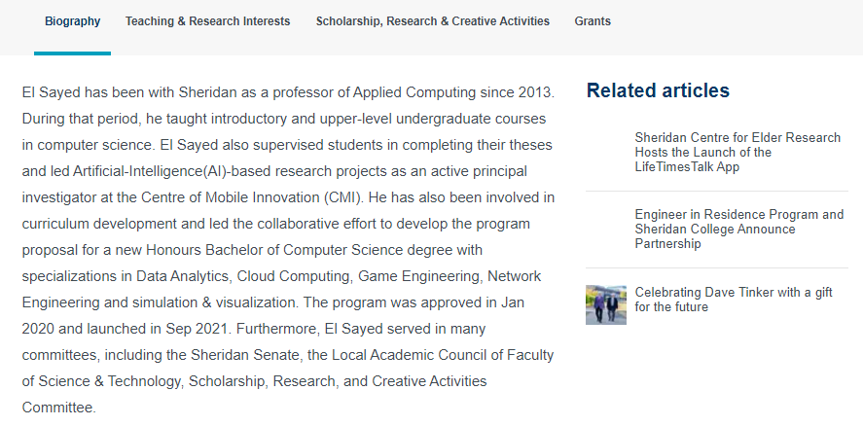
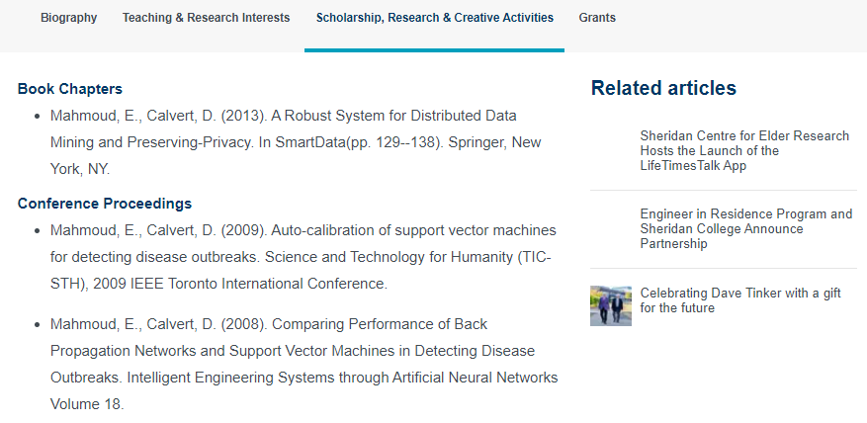
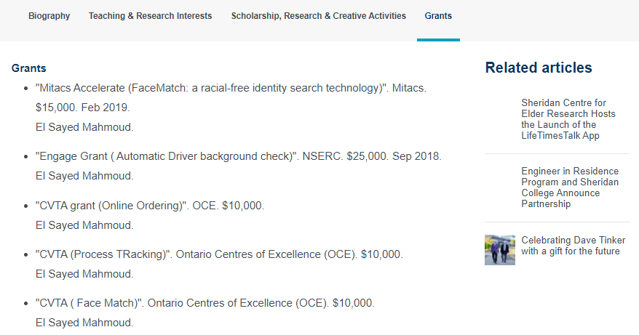
Sample web profile cont’d
View full Faculty Profile here

Slide 8
Final Notes on Privacy (FAQ)
The Faculty180 database can only be accessed internally. It is not a website.
Individual users can only see information about other users when they search in these categories: teaching interests/research interests, biography, SRCA, and grants.
Users can choose to publicly display information from these categories in a profile on Sheridan’s external website.​
Personal information is NOT visible to internal members when they search for colleagues or part of the online profile published to Sheridan’s external website.

Slide 9
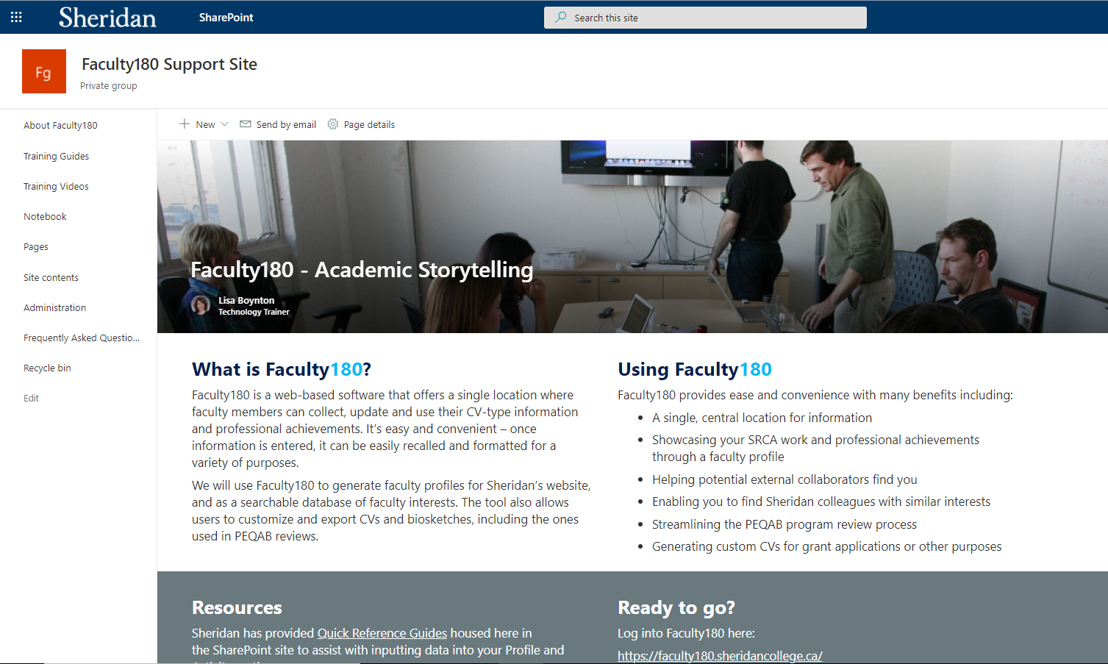
Resources
Faculty180 Support Site

Slide 10
Cheryle Moreau
Assistant to the Vice Provost, Research
cheryle.moreau@sheridancollege.ca​
Research Office
research@sheridancollege.ca
Technical Support for Faculty180:
servicedesk@sheridancollege.ca
Thank You!
Questions? Please contact us!

