Slide 1
Magnetic Integration of Filter Inductors in Electric Vehicle Fast Charging Infrastructure
By: Ning Zhu
School of Mechanical and Electrical Engineering Technology
Faculty of Applied Science and Technology (FAST)
Sheridan College
October 26, 2022

Slide 2
Contents
Background of Electric Vehicles (EVs) and Fast Chargers
Motivations and Objectives
Solution Design and Validation: A Further Magnetic Integration
Contributions, Conclusions and Future Work
‹#›

Slide 3
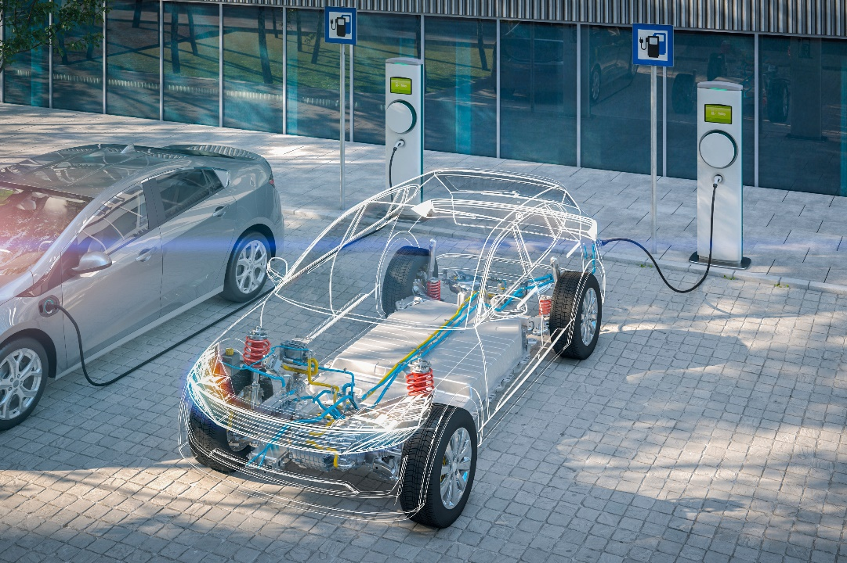
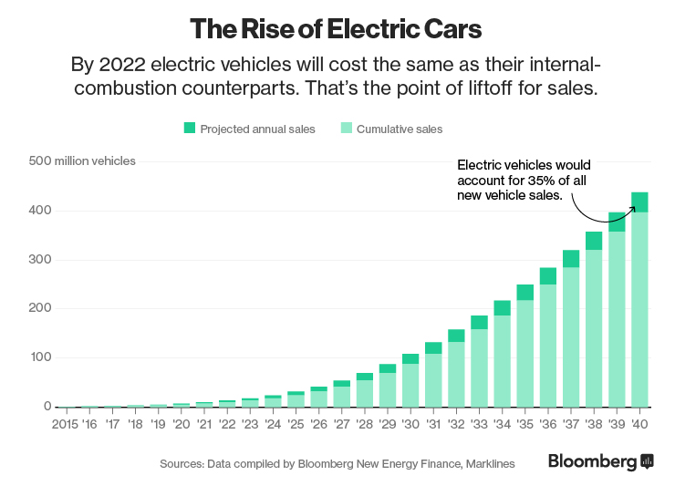
Background of Electric Vehicles (EVs)
Electrification has been playing an essential role and will reach further and deeper into the transportation sector, motivated by the energy transition to a zero-carbon- emission-based economy to mitigate climate change.
In 2020, electric vehicle (EV) fleet > 8.5 million, with almost 2 million new sales
Expanding at a rapid pace, with a projection indicating that 58% of vehicles will be EVs by 2040.
‹#›

Slide 4
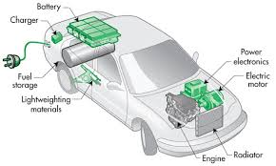
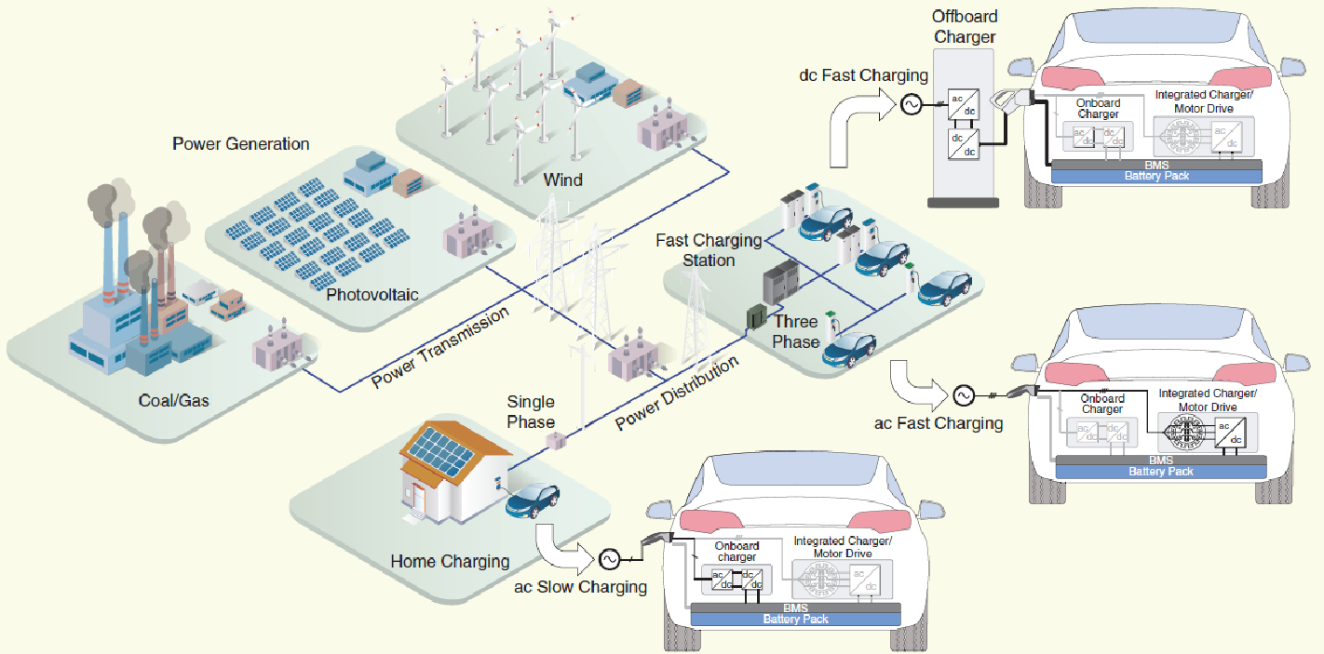
Background of EV Chargers
EV Charging (charging times ≈ the time it takes to fuel conventional vehicles)
Onboard slow ac chargers (8 – 11 hours)
Fast ac integrated chargers (3 – 5 hours)
Offboard dc fast charging infrastructure (15 mins)
‹#›

Slide 5
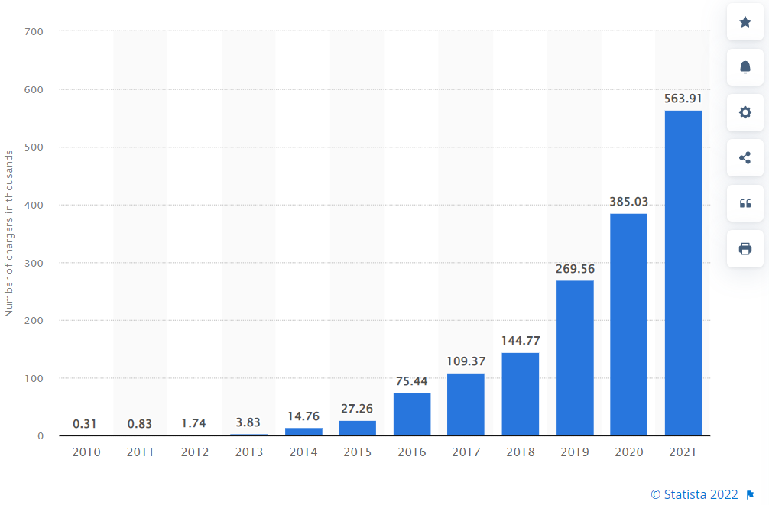
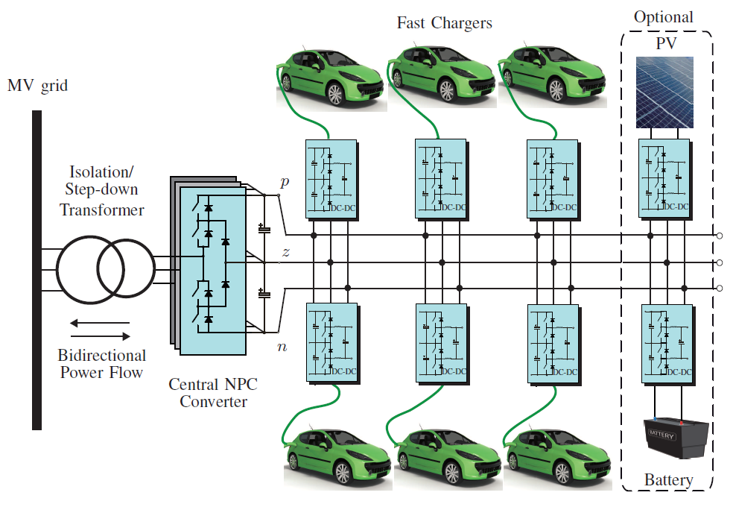
Background of Offboard Fast DC Chargers
Number of publicly available fast EV chargers worldwide
Key onboard charger (OBC) targets high maximum power, small size, light weight and high efficiency.
Offboard dc fast chargers also targets above features with low cost.
A bipolar dc bus architecture for megawatt-level EV fast charging stations
Features: high-power capacity, reliable, flexible for connections
Challenges: imbalanced power and voltage
‹#›

Slide 6
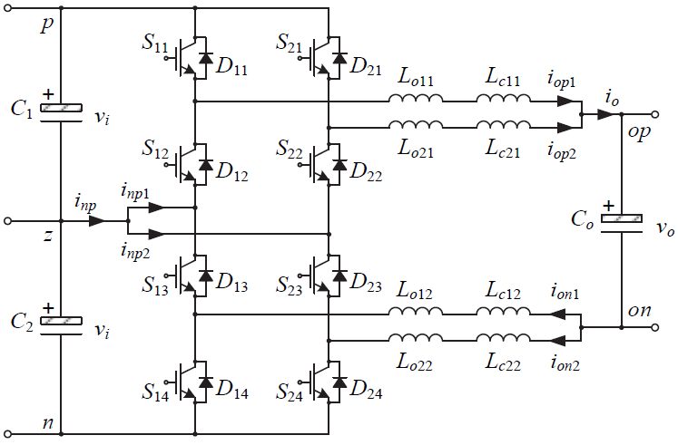
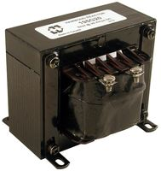
Background of the DC-DC Converter Topology
Parallel three-level dc-dc converters as the EV fast- charging ports or interfaces to energy storage and renewable power sources
Interleaving operation to solve the imbalanced power and voltage issue due to random arrival of EVs and intermittency of renewable energy generation
Circulating currents and resultant larger current ripples caused by the interleaving operation lead to extra losses and stresses to power semiconductors.
Bulky filter inductors and separate chokes to mitigate the circulating current
‹#›

Slide 7
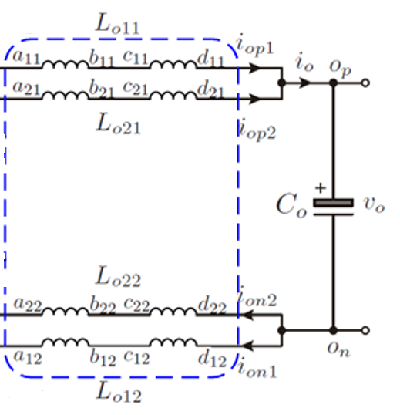
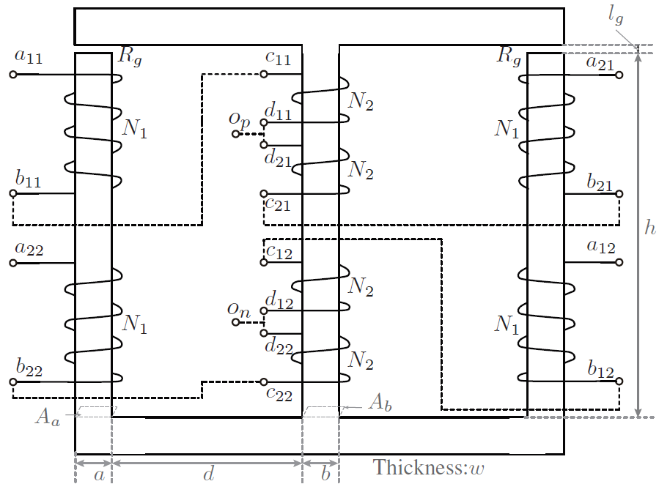
Background of State-of-the-Art
The state-of-the-art solution integrated all 8 coils pnto one magnetic core and adjusted the circulating and output inductances by changing the corresponding number of coils.
Although the inductor size, weight and losses have all been reduced, the number of coils was not deducted, and this was not an optimal design yet, from the power density, efficiency and cost points of view.
‹#›

Slide 8
Motivations and Objectives
To Find out an optimal magnetic integrated design for filter inductors in the offboard dc EV fast charging infrastructure
With the minimum number of coils wound on one shared core
Minimize the weight and size, and maximize the power density
Reduce the iron and copper losses, and further improve the efficiency
Decrease the iron and copper material use, and save the cost
‹#›

Slide 9
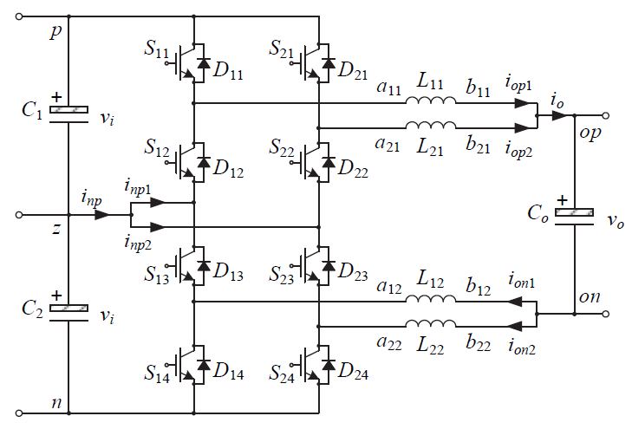
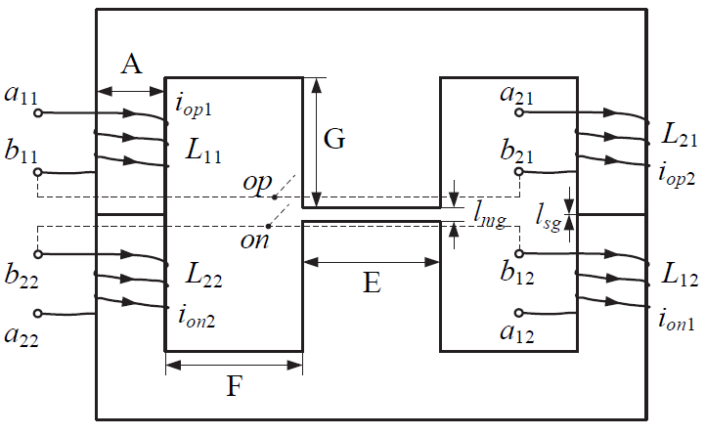
A New Solution Design: Structure
Combined the output filter winding and circulating inductance winding on each path into one with a minimized total number of coils of 4
One shared core with a simplified standard EE shape and an air gap in the middle leg
The circulating and output inductances will be adjusted by controlling the air gaps and/or choosing a core material with its specific permeability.
‹#›

Slide 10
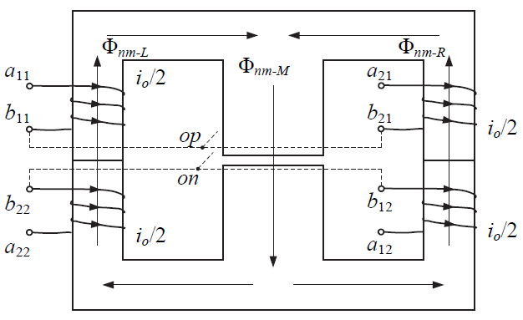
A New Solution Design: Output Inductance
where N is the number of turns of each coil, i_{o} is the total output current, ℜ_{c} is the reluctance of the periphery of the EE core; ℜ_{sg} is the reluctance of each side-leg air gap; ℜ_{m} is the reluctance of the middle-leg core; and ℜ_{mg} is the reluctance of the middle-leg air gap.
‹#›

Slide 11
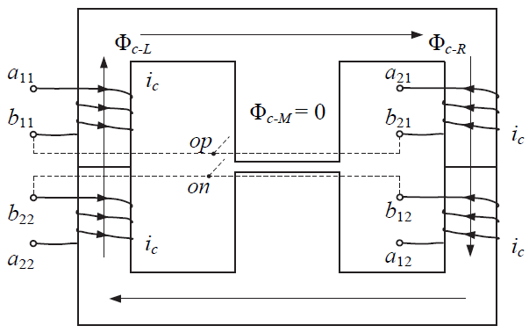
A New Solution Design: Circulating Inductance
Circulating-to-Output Inductance Ratio
where l_{c} and l_{m} present the mean circumference of the core and the length of the middle leg; l_{sg} and l_{mg} are the air-gap lengths of each side leg and middle leg, respectively; μ_{r} denotes relative permeability of the core material.
‹#›

Slide 12
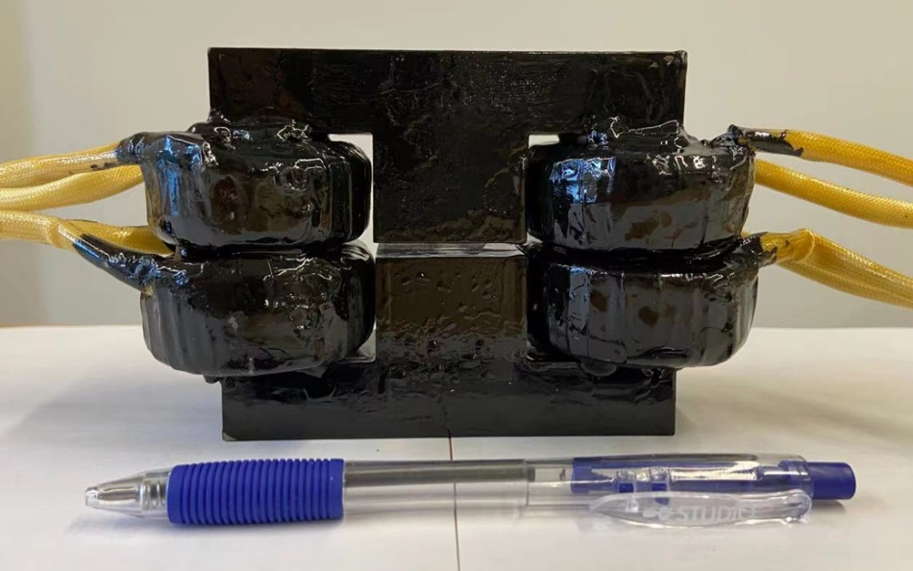
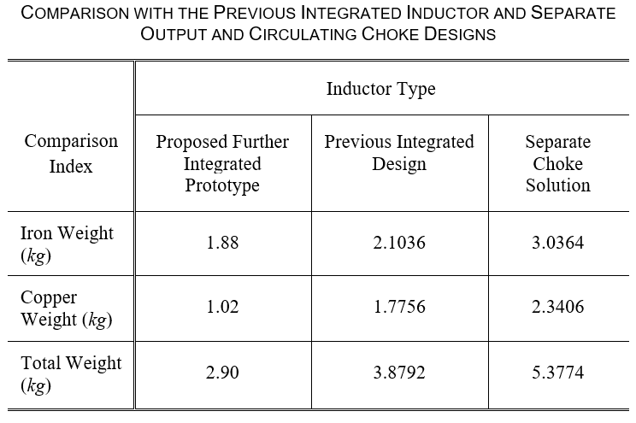
Prototype Design and Comparison
The required high circulating-to-output inductance ratio is implemented and adjusted by magnetic characteristics of the core material and air gaps in different magnetic paths.
Prototype: 1.2 kW, f_{sw} = 4.32 kHz, V_{dc} = 200 V, L_{o} = 4 mH, L_{c} ≥ 36 mH (ε ≥ 9)
10.6% and 38% declines in iron weight and core loss reduction
42.5% and 56.4% decreases in copper weight and ohmic loss
25.2% and 46% drops in total weight with power density improvement, and material and cost savings
‹#›

Slide 13
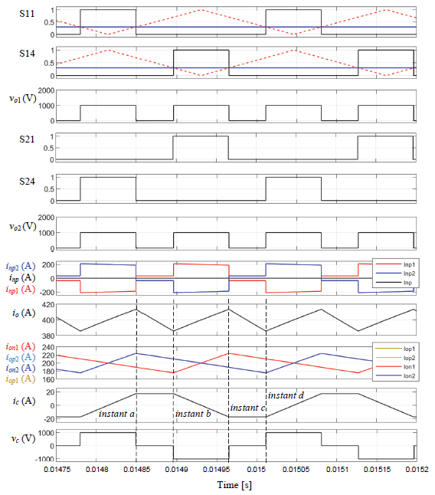
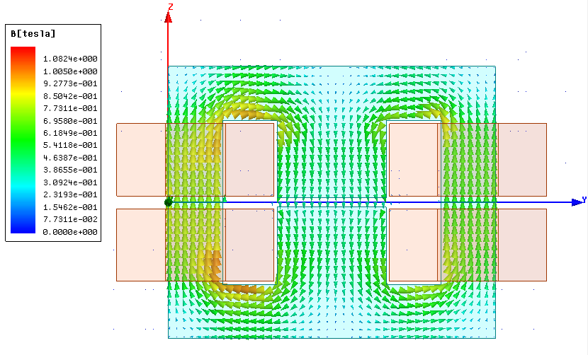
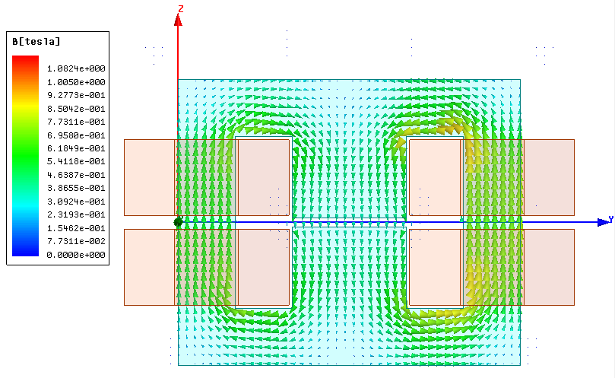
Simulation Validations
Simulated flux density (B)
Instant a
Simulation Results, L_{o} = 4.03 mH, L_{c} = 39.5 mH (l_{sg} ≤ 0.16 mm specified)
Instant b
‹#›

Slide 14
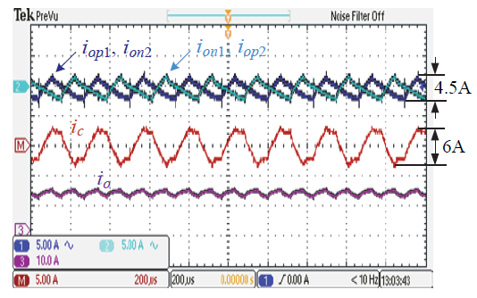
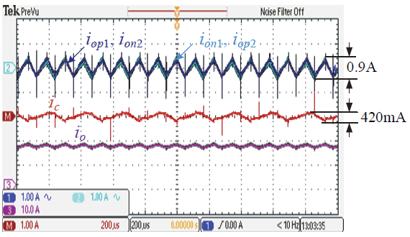
Effect Test Validation
Current waveforms of the parallel three-level dc-dc converter with four 2 mH separate inductor
The same current waveforms using the proposed further integrated inductor prototype
From top to bottom: Channels 1 and 2 – the individual output currents of each converter unit measured in ac coupling i_{op1} or i_{on2} and i_{on1} or i_{op2}, Chanel M – the circulating current, i_{c}, and Channel 3 - the total output current, i_{o}
The individual current ripple reduces by 5 times, from 4.5 A to 0.9 A; The peak-to- peak circulating current decreases by more than 14 times, from 6 A to 420 mA.
‹#›

Slide 15
Contributions and Conclusions
Proposed a further magnetic integration for filter inductors in Electric Vehicle (EV) offboard dc fast charging infrastructure
The innovation takes better effects of output current filtering and circulating current elimination than the state-of-the-art technology, but reduces the iron, copper and total weight by 10.6%, 42.5% and 25.2%, respectively, leading to a higher power density (a smaller footprint with the same high-power capacity) and substantial material and cost savings.
The corresponding iron and copper ohmic loss deductions are also achieved, improving the system efficiency.
The further magnetic integration does not only minimize the number of coils wound on one shared core but simplifies the structure and design process.
This methodology can be extended to other circuit topologies of EV fast charging infrastructure.
‹#›

Slide 16
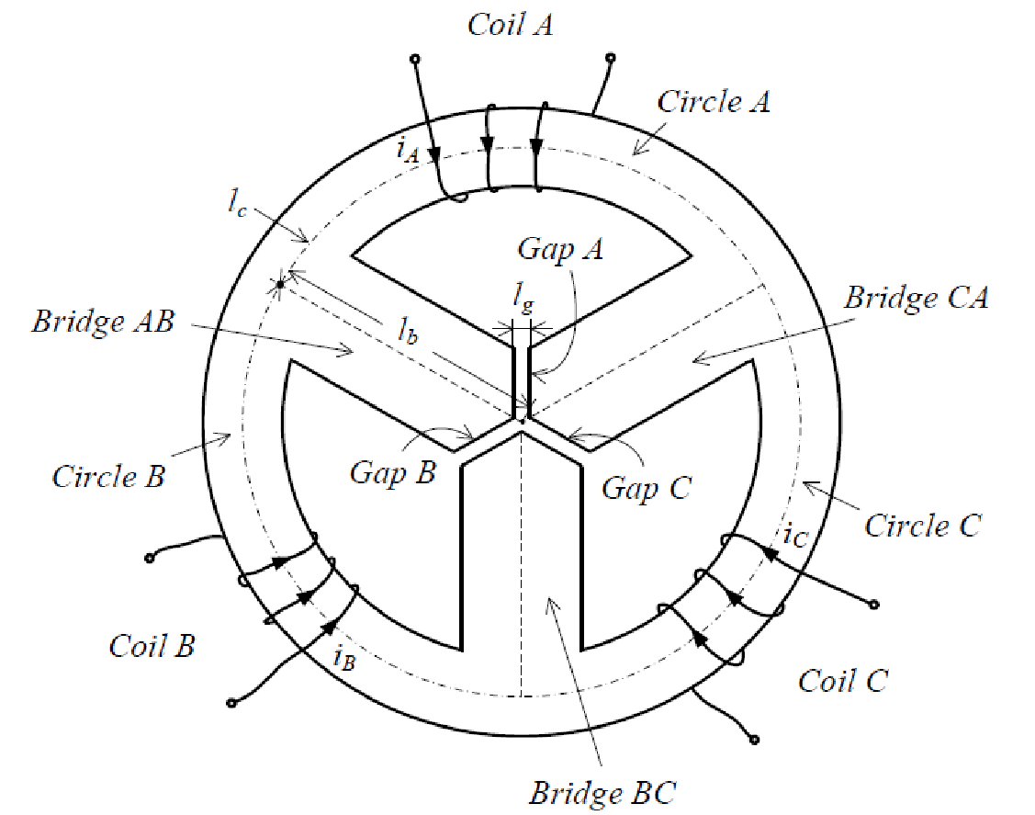
Future Work
Modularity (and interleaving operation) appears to be the key to success in EV fast charging with high power capacity.
Generalization of the magnetic integration in filter inductors of the other offboard dc fast charging infrastructure
Three-channel interleaving with three coils wound on one shared core as the filter inductor
‹#›

Slide 17
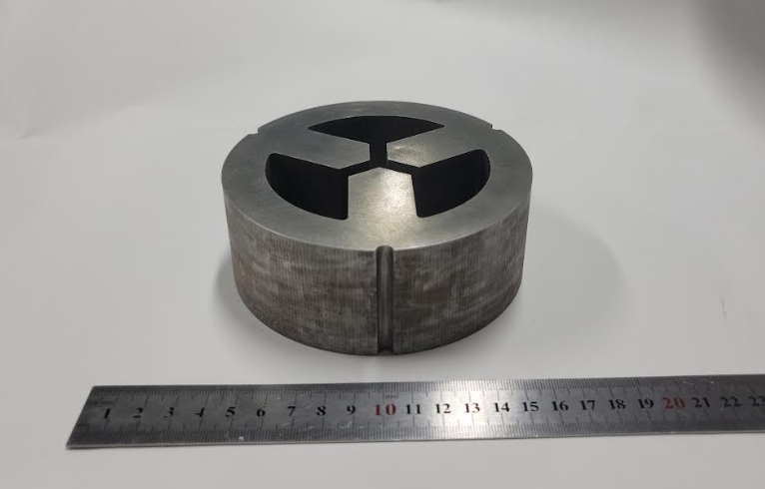
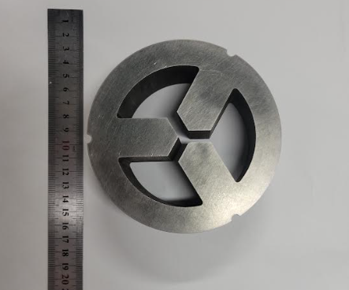
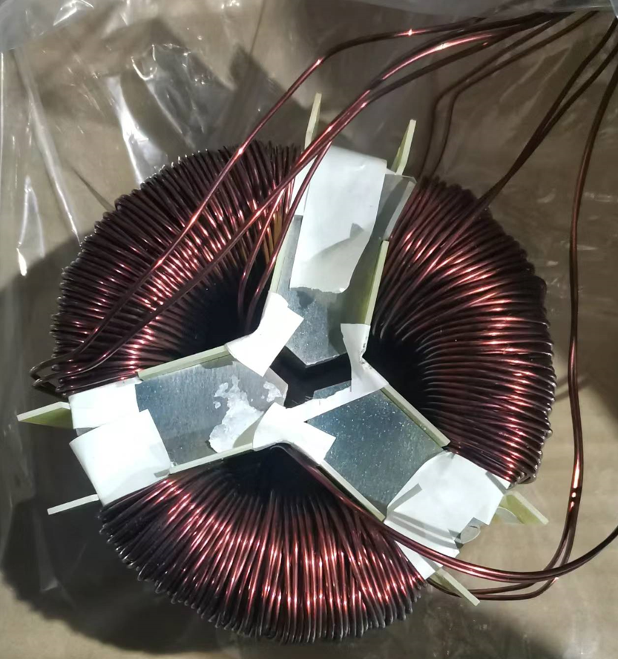
Future Work: Three-Channel Integrated Inductor
Both design and simulation done
Prototype ready
To be measured and shipped for final test validation
‹#›

Slide 18
Bibliography and Dissemination
Bibliography:
[1] S. Rivera, S. Kouro, S. Vazquez, S. M. Goetz, R. Lizana & E. R-Canaval, “Electric vehicle charging infrastructure: from grid to battery,” IEEE Mag. Ind. Electron., vol. 15, no. 2, pp. 37-51, Jun. 2021.
[2] T. Randall, “Here’s how electric cars will cause the next oil crisis,” Energy News, Articles – Commentary, online: Here's How Electric Cars Will Cause the Next Oil Crisis - Energy News - Institute of Energy of South East Europe (iene.eu)
[3] L. Tan, N. Zhu and B. Wu, “An integrated inductor for eliminating circulating current of parallel three-level dc-dc converter-based EV fast charger,” IEEE Trans. Ind. Electron., vol. 63, no. 3, pp. 1362-1371, Mar. 2016.
[4] Online Resource: Publicly available fast EVSE chargers worldwide | Statista
[5] Online Resource – Hammond Manufacturing Product Image.
Dissemination
[1] N. Zhu, J. Shen & J. Wang, “A further magnetic integration of filter inductors for circulating current elimination in parallel three-level dc-dc converter-based EV fast chargers,” submitted to IEEE Trans. Ind. Electron. (SCI, Impact Factor: 8.236), reviewed and in revision.
‹#›

Slide 19
Thanks
‹#›

