Slide 1
Learning Analytics: A Foundation
Created by: Patrick Molicard-Chartier and Kyle Mackie
Additional contributions by Michael Carrigan
Centre for Teaching and Learning, Sheridan College
October 19, 2021
Notes:
Patrick

Slide 2
We acknowledge the land for sustaining us and for providing us with the necessities of life. This territory is covered by the Dish with One Spoon treaty and the Two Row Wampum treaty which emphasize the importance of joint stewardship, peace, and respectful relationships. As we reflect on land acknowledgements, let us remember that we are all stewards of the land and of each other.
We recognize the land on which we gather has been and still is the traditional territory of several Indigenous nations, including the Anishinaabe, the Haudenosaunee Confederacy, the Wendat, the Métis, and the Mississaugas of the Credit First Nation. Since time immemorial, numerous Indigenous nations and Indigenous peoples have lived and passed through this territory.
Sheridan affirms it is our collective responsibility to honour the land, as we honour and respect those who have gone before us, those who are here, and those who have yet to come. We are grateful for the opportunity to be learning, working, and thriving on this land.

Slide 3
Agenda
Facilitator Introductions
Learning Outcomes
What Are Learning Analytics?
Gaining Insights from Data
Exploring Learning Analytics in SLATE
Question Period
Notes:
Patrick

Slide 4
Meet The Facilitators
Patrick
Kyle
Mike
Name: Patrick Molicard-Chartier
Email: patrick.molicardchartier@sheridancollege.ca Role: Educational Development Consultant, CTL
Name: Kyle Mackie Email: hello@kylemackie.ca
Role: Educational Consultant (external)
Name: Mike Carrigan Email: michael.carrigan@sheridancollge.ca
Role: Academic Skills Librarian

Slide 5
Intended Learning Outcomes
By the end of this session, participants will be able to:
Define learning analytics;
Identify the tools available in SLATE that produce actionable learner data;
Gain insights from data;
Recognize the ethical implications of measurement, collection, analysis, and reporting of data about learners.
Notes:
Patrick – mentimeter activity – word cloud – What are Learning Analytics to you?

Slide 6
What Are Learning Analytics?
“...the measurement, collection, analysis and reporting of data about learners and their contexts, for purposes of understanding and optimising learning and the environments in which it occurs.”
(1st International Conference on Learning Analytics and Knowledge, 2011)

Slide 7
What Are Learning Analytics?
“...the adoption of educational technologies has afforded a new opportunity to gain insight into student learning.”
(Gašević, Dawson & Siemens, 2015)
​

Slide 8
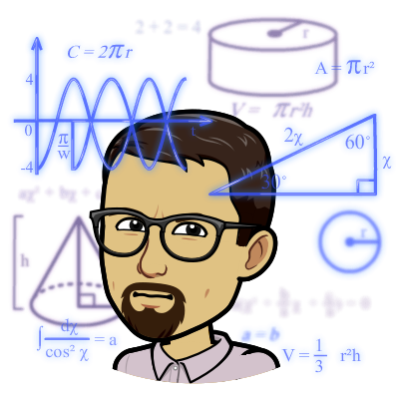
Gaining Insights From Data
"Data analytics allows campus leaders and staff to know their students via evidence, in real time, and helps them to be prepared to act on this knowledge."
(Carmean, Kil & Baer, 2021)

Slide 9
Data is Messy
"The answers are there, buried in the data."
-The Illusive Man
(Bioware. (2010). Mass Effect 2. Electronic Arts.)

Slide 10
Gaining Insights From Data
Analytic sensemaking is a complex and evolving skill developed through practice in an authentic teaching environment.
(Molenaar & Knoop‐van Campen, 2018; Herodotou, et al., 2020; Tarmazdi, et al., 2015)
Asking Questions
Finding Answers
Taking Action

Slide 11
Gaining Insights From Data

Slide 12
Gaining Insights From Data
Checkpoints
Did they sign up for a group assignment?
Process
Network
Content
Have students accessed the resources?
Have they submitted their work on time?
Have they missed several assignments?
Did they download a file for reading?
How do learners progress through the course materials?
Do different learners take different paths?
Do learners review all resources before completing online quizzes or submitting assignments?
Who talks with whom?
Who comments on which discussion posts?
How do group members interact?
How do learners use collaborative tools?
Learner-created content (discussion posts, submitted assignments, journal entries, etc.)
What are the patterns? (words, common themes, or topics.)

Slide 13
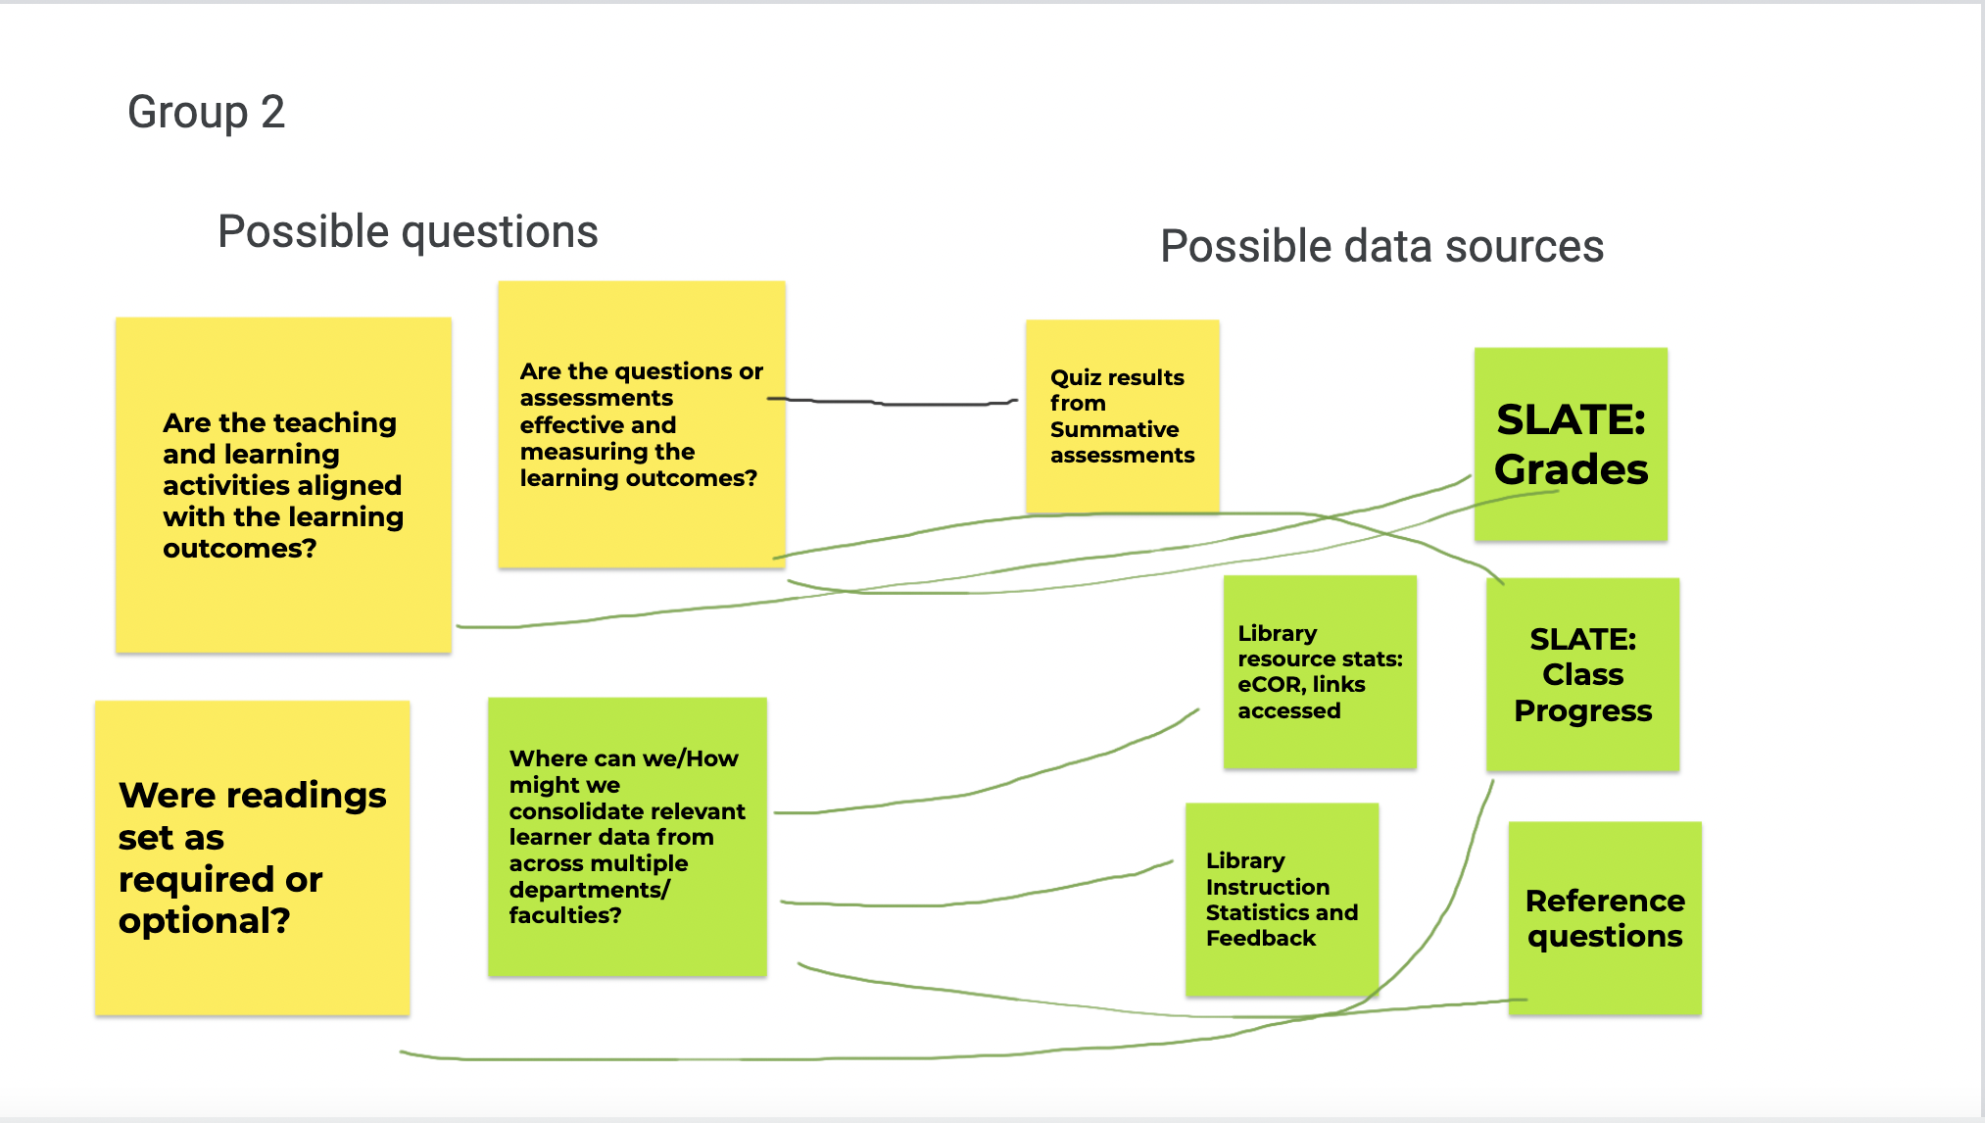
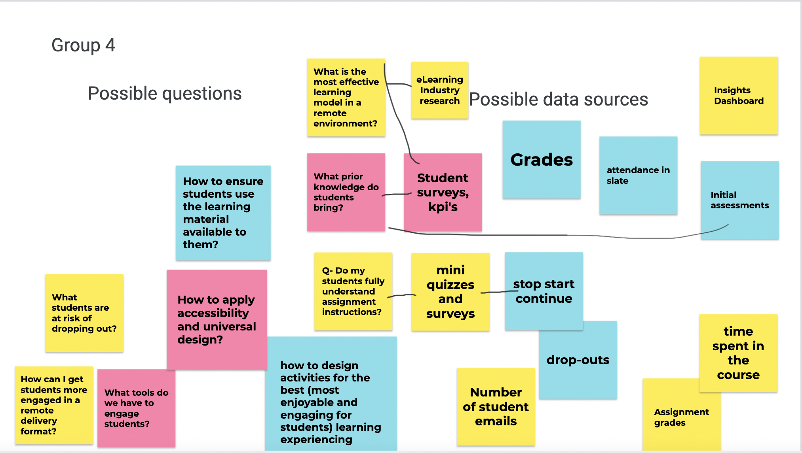
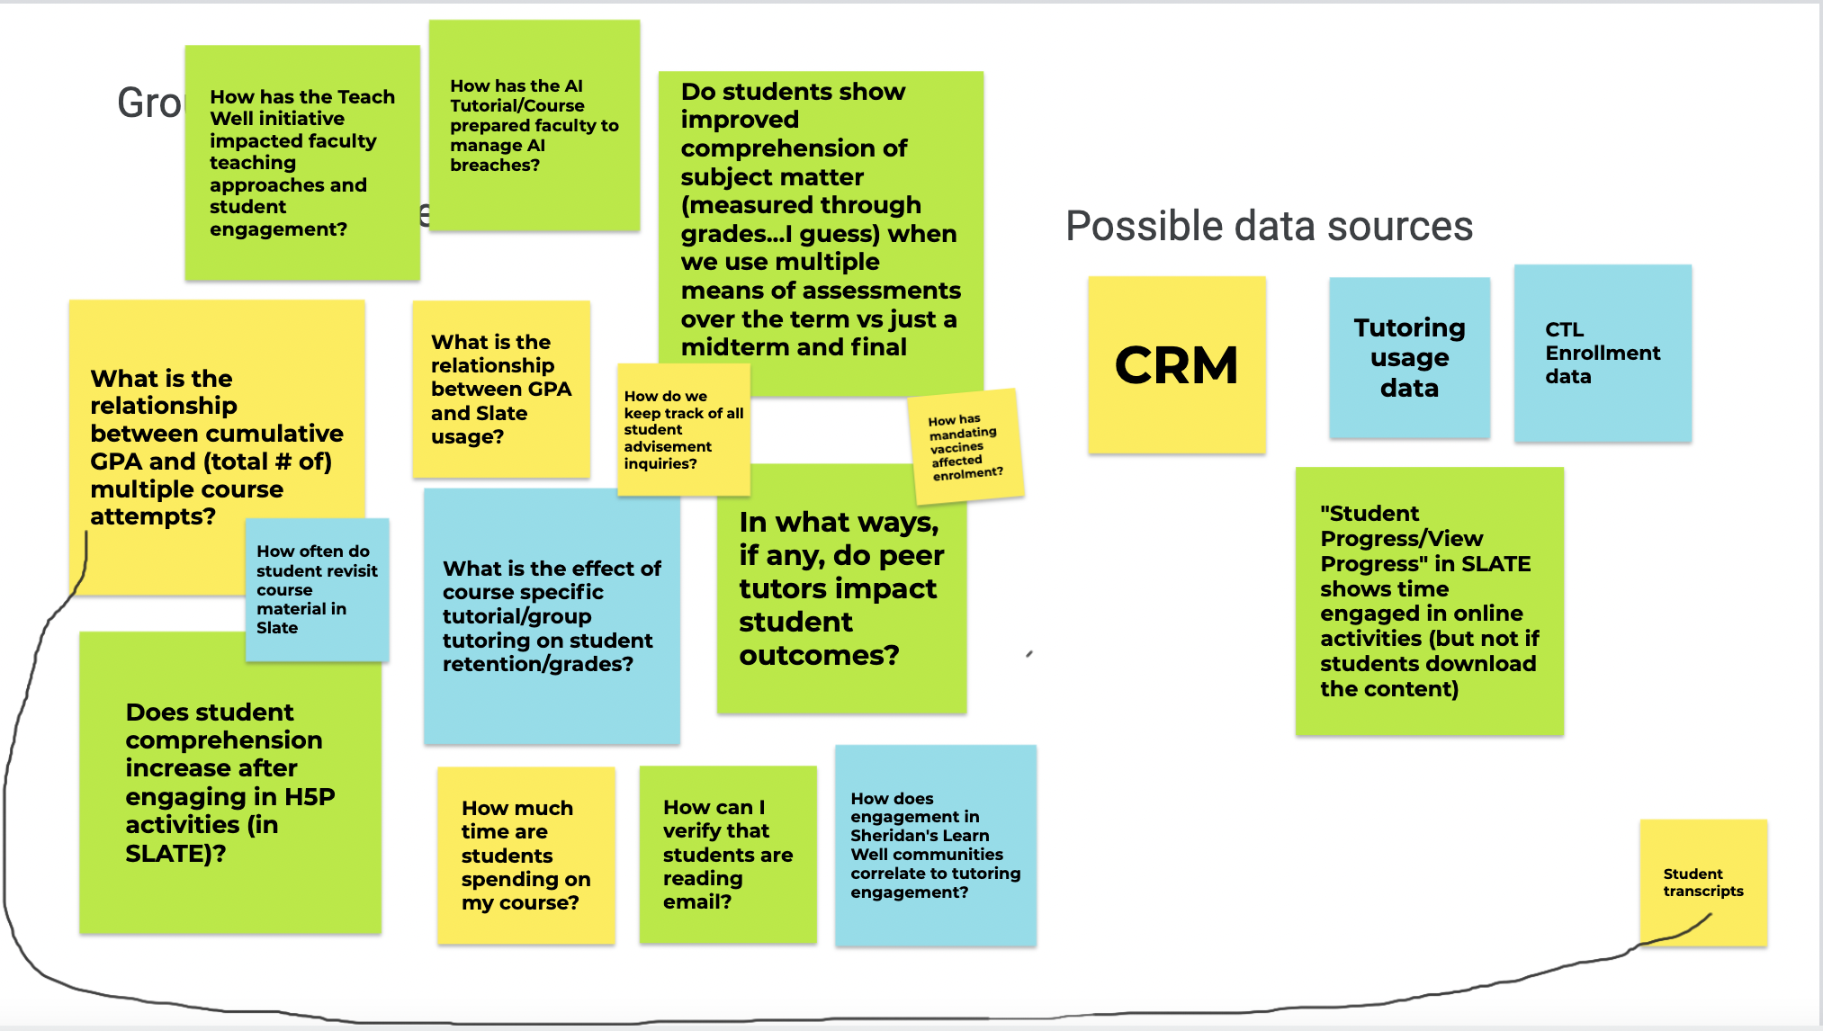
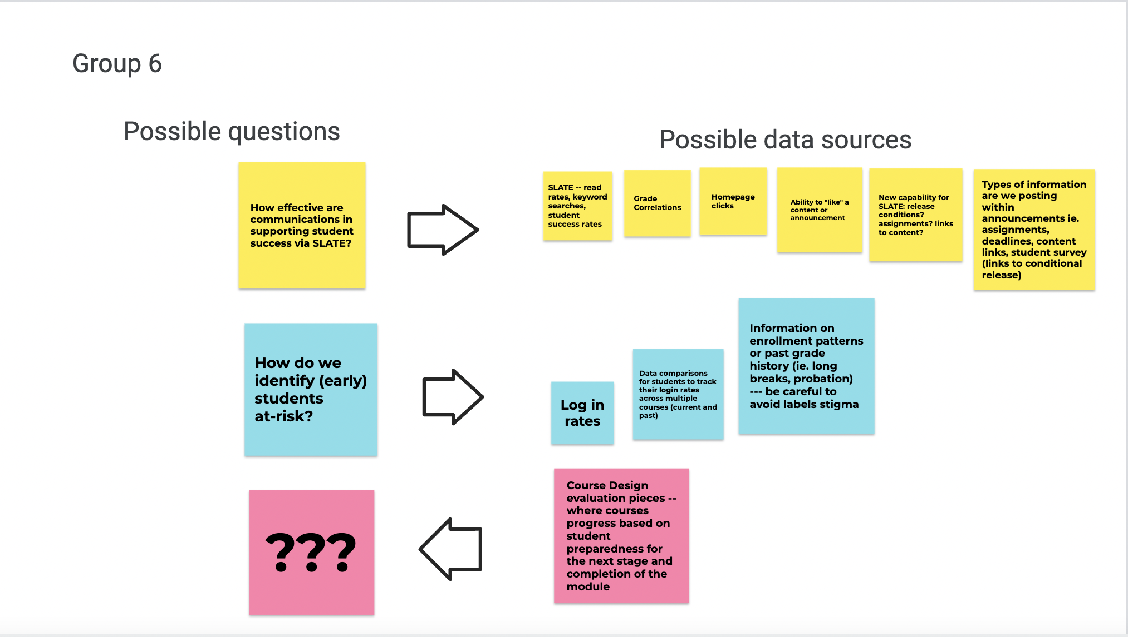
Review of CoP
- What questions do you have?
- What thoughts still linger?

Slide 14
Gaining Insights From Data
Goal-Oriented Questions
Problem-Oriented Questions
Instructional Modification Questions
Notes:
“When do they view the assignment between Wednesday morning and
Sunday? Do they give themselves enough time to think about the
prompt or do they just write something very quickly to show that they
have a submission?”
“I have a student who just did terribly on an exam. I want to know: has
that student been coming to class?”
“One thing I struggle with is knowing when my students are working on
this assignment, so when I can send them an email that’s
helpful to them, instead of having it buried somewhere”

Slide 15
Gaining Insights From Data
Asking Questions
Finding Answers
Taking Action
Examining Expectations
Adjusting Expectations
Finding Answers
Notes:
Question: Why are some students not answering any questions and being very quiet during group activities?
Expectation (hypothesis): These students were not looking at the materials
Finding Answers (reading and analyzing data): They were looking at it, just closer to class time
Adjusting Expectations (prediction): Their assignments won't be thoughtful
Finding Answers: Their assignments are thoughtful. It's clear they are engaging with the material. They're working at a different pace, in a different way.
Taking Action: Adjust timeline for readings, introduce flexibility

Slide 16
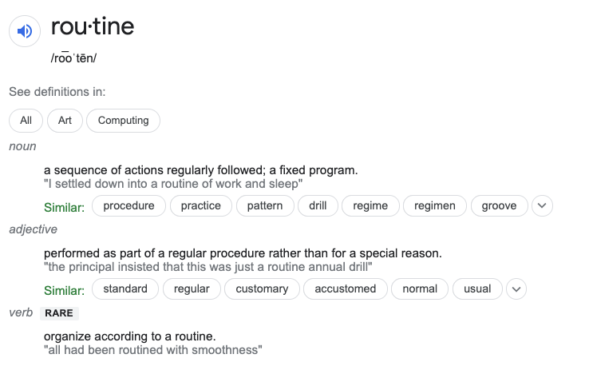
Gaining Insights From Data

Slide 17
Exploring Learning Analytics In SLATE

Slide 18
Exploring Learning Analytics In SLATE

Slide 19
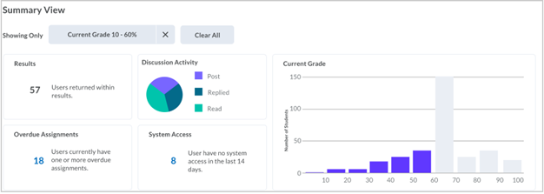
Exploring Learning Analytics In SLATE

Slide 20
Questions?

Slide 21
Thanks For Joining!
Patrick Molicard-Chartier ​
Educational Development Consultant, CTL
patrick.molicardchartier@sheridancollege.ca ​
Mike Carrigan
Academic Skills Librarian
michael.carrigan@sheridancollege.ca
Kyle Mackie
Educational Development (external)
hello@kylemackie.ca

Slide 22
Additional Resources
Teaching and Learning Insights at Sheridan College
Why Data Matters for Student Success in a Post-Pandemic World
What is Learning Analytics & How Can it Be Used?
Learning Analytics 101 (NYU Learning Analytics Research Network: LEARN)
Handbook of Learning Analytics

Slide 23
References
Carmean, C., Kil, D., & Baer, L. (2021). Why Data Matters for Student Success in a Post-Pandemic World. Retrieved October 1, 2021, from https://er.educause.edu/articles/2021/8/why-data-matters-for-student-success-in-a-post-pandemic-world
Gašević, D., Dawson, S., & Siemens, G. (2015). Let’s not forget: Learning analytics are about learning. TechTrends, 59(1), 64-71.
Herodotou, C., Naydenova, G., Boroowa, A., Gilmour, A., & Rienties, B. (2020). How can predictive learning analytics and motivational interventions increase student retention and enhance administrative support in distance education?. Journal of Learning Analytics, 7(2), 72-83.
Molenaar, I., & Knoop-van Campen, C. A. (2018). How teachers make dashboard information actionable. IEEE Transactions on Learning Technologies, 12(3), 347-355.
Pannekoek, P. F., Hirst, T., Atkisson, M., Wiley, D., Fancsali, S., Bader-Natal, A. & Greer, J. (2011) 1st International Conference on Learning Analytics and Knowledge.
Tarmazdi, H., Vivian, R., Szabo, C., Falkner, K., & Falkner, N. (2015). Using learning analytics to visualise computer science teamwork. In Proceedings of the 2015 ACM Conference on Innovation and technology in computer science education (pp. 165-170).
Wise, A. F., & Jung, Y. (2019). Teaching with analytics: Towards a situated model of instructional decision-making. Journal of Learning Analytics, 6(2), 53-69.

