Slide 1

A Pilot Study Considering Pain-relieving Medications and Opioid Knowledge and Use Among Elite Athletes.
Vandertuin J, Abdulla D, Lowther-Gagnon S, Manolakos M
Sheridan College, Brampton, ON

Slide 2
Athletes and PRM
NSAID use amongst athletes reported at 92% in season with 7-50% reporting weekly analgesic use
  1 in 2 youth athletes weekly reporting NSAID use 1,3
Opioid use has been reported at 5-8% of athletes
  depending on the sport, sex of athlete and whether it is reported 4,5,7
Analgesic use is relatively safe, long-term use is not recommended due to AEs 1
Opioid use is for short term relief
  IOC recommends non-pharmacological methods to manage longer term pain 2
Notes:
PRM AE:
Common AEs include
GI bleeding
Hematuria
CV events
Renal functioning disorder
Hepatoxicity
Opioid Aes
Addiction, dizziness, nausea, vomiting, tolerance, respiratory depression, cognitive disturbance, constipation and death

Slide 3
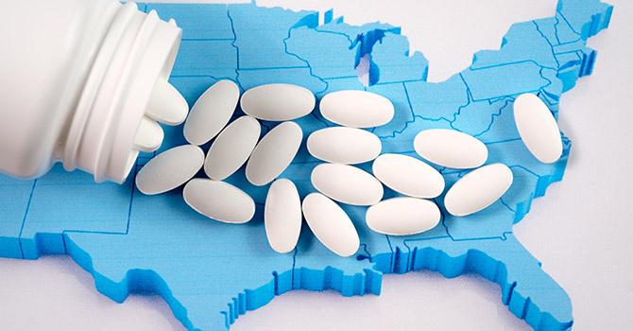
Purpose
To understand PRM and opioid use from a Canadian perspective for elite level athletes at a collegiate level

Slide 4

A P' knowledge, attitudes and use of PRM
Methods
Survey was developed from previous research 8
Survey was face validated by 4 elite athletes
Survey sent to AT students who were current or former varsity athletes
Survey was administered from February – March 2023
44 individuals completed the survey

Slide 5
Results
Results

Slide 6
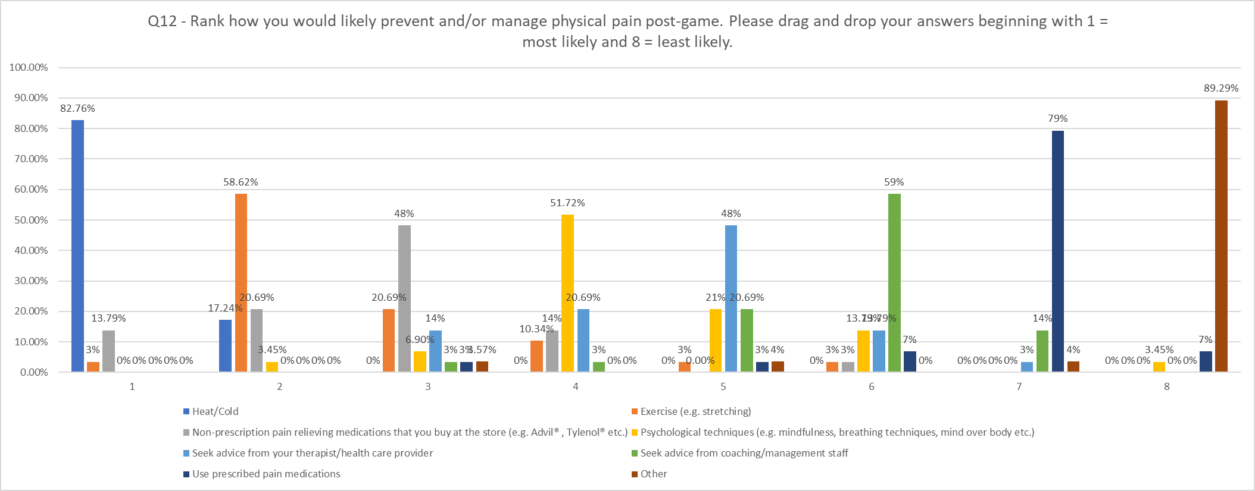
#1: Heat/cold
#2: Exercise
#3: Non-prescription pain meds
#4: Psychological techniques
#5: Seek advice from therapist/health care provider
#6: Seek advice from coaching/management staff
#7: Use prescribed pain meds
#8: other
Results

Slide 7
Sources of knowledge
32% indicated that they had no knowledge of opioids
Where knowledge was obtained (in ranked order)
  1: Coaching staff
  2: Friends/family
  3: Media and personal experience
  4: Therapists and physicians
  5: School
  6: Teammates
Personal experience with opioids
  Family/friends (25%),
  Personal experience from prescription (22%),
  Recreational use (18%)

Slide 8
Opioid use

Slide 9
Application to AT
Athletes use PRM to alleviate pain pre, during and post-game
Athlete education imperative
  AEs
  Use and misuse
  Focus on non-pharmacological pain management
    AT must be prepared to discuss PRM/O
ATs must be educated on PRM/O minimize athletes' reliance on potential unreliable sources
Provide a space that is open and free of judgement
Inquire about PRM/O use

Slide 10
Limitations
This study was conducted on AT students
  they may be least likely to consult other therapists/health care professionals
Questions whether survey completed by actual elite athletes
  self-reported
Knowledge was self-reported and not measured

Slide 11
Major references
1. Pedersen JR, Andreucci A, Thorlund JB, et al. Prevalence, frequency, adverse events, and reasons for analgesic use in youth athletes: A systematic review and meta-analysis of 44,381 athletes. J Sci Med Sport. 2022;25:810-819.
2. Hainline B, Derman W, Vernec A. et al. International Olympic Committee consensus statement on pain management in elite athletes. Br J Sports Med 2017;51(17):1253-1258
3. Harle CA, Danielson ED, Derman W et al. Analgesic management of pain in elite athletes: a systematic review. Clin J Sports Med 2018;28(5):417-426
4. Veliz PT, Boyd C, McCabe SE. Playing through pain: sports participation and nonmedical use of opioid medications among adolescents. Am J Public Health. 2013;103(5):e28-e30. doi:10.2105/AJPH.2013.301242
5. Ford JA, Pomykacz C, Veliz P, McCabe SE, Boyd CJ. Sports involvement, injury history, and non-medical use of prescription opioids among college student: An analysis with a national sample. Am J Addiction. 2018;27:15-22.
6. Benyamin R, Trescot AM, Datta S, et al. Opioid complications and side effects. Pain Physician. 2008;11(2 Suppl):S105-S120.
7. Ekhtiari S, Yusuf I, AlMakadma Y, MacDonald A, Leroux T, Khan M. Opioid Use in Athletes: A Systematic Review. Sports Health. 2020;12(6):534-539. doi:10.1177/1941738120933542
8. Vandertuin JF, Abdulla DA, Lowther-Gagnon S. Adolescent and young athletes' knowledge of pain-relieving medications. Submitted for publication.

Slide 12
Thank you!
Questions?

