Slide 1
Adaptive Technology Abandonment and Engagement in Post-Secondary Contexts:
Changing the Conversation.
10th Annual Accessibility Conference, May 30, 2018 University of Guelph

Slide 2
Today’s Presenters
Janice Fennell, PhD: Manager of Accessible Learning Services & AODA, Mohawk College
Andrea Zians: Adaptive Technologist and Learning Skills Advisor, Accessible Learning Services, Mohawk College

Slide 3
Agenda
Background and Research
Definitions
Benefits of Adaptive Technology (AT)
Fennell Research Findings
Implications of AT abandonment
Our College Experience
Questions We Asked
AT Abandonment in our Setting (what it looks like, trends, possible reasons)
Our Response
Future Directions
Questions

Slide 4
Definitions
Adaptive Technology (AT): The term “Assistive Technology” denotes “any item, piece of equipment, or product system, whether acquired commercially off the shelf, modified, or customized, that is used to increase, maintain, or improve functional capabilities of children with disabilities”(Reed & Bowser, 2005, p. 62).
Adaptive Technology Abandonment: Under-Utilization of AT, devices being discarded after a short period of time (Scherer, 2005)

Slide 5
Benefits of Adaptive Technology
Hopkins (2004) – AT enables individuals with disabilities to negotiate areas of challenge
Not a panacea – but greater efficiency and independence in reading and writing tasks (Forgrave, 2002)
Allows students to access curricula (Edyburn, 2005)
Levels the playing field for students with disabilities (Kintsch & DePaula, 2002)

Slide 6
Background & Research
Janice Fennell PhD dissertation (2016), York University, Toronto, ON
Technology and Disability Identity: "Now you See Me, Now you Don't"
Investigated:
The impact of Technology on the identity of students with invisible disabilities
Factors which lead to AT abandonment or AT engagement.
Funding and AT abandonment
AT training in the K-12 context

Slide 7
Fennell discusses:

Slide 8
Cost Benefit Analysis of Adaptive Technology

Slide 9
Our College Experience
Questions we asked
What does AT abandonment look like in our environment?
How can we improve AT match/fit?
How can we improve AT engagement?
How can we minimize the effects of (dis) engagement on capacity and institutional resources?

Slide 10
What AT Abandonment Looks Like in our Setting
Student not using AT in testing situations despite having the accommodation for AT during testing.
Misuse of AT process to obtain laptop (reduced quite a bit)
Non-attendance for training to learn use of AT (not following through with AC referral) Missed appointments – no show.
Student meeting with counsellor to fill out BSWD forms for technology but never picking up cheque or worse picking up cheque and not spending it.
Failure to collect equipment or alternative format from technician
Discontinuance after 1 or 2 uses
Equipment left in backpacks, at home not accessed
Student not using technology and never returning to address the unmet learning challenge.
Student not renewing license or requesting equipment next semester

Slide 11
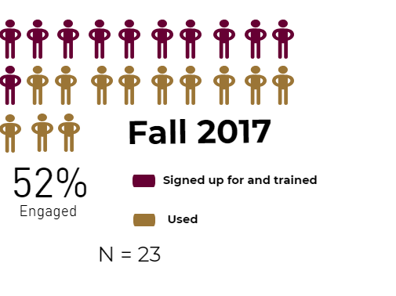
Notetaking Express Engagement

Slide 12
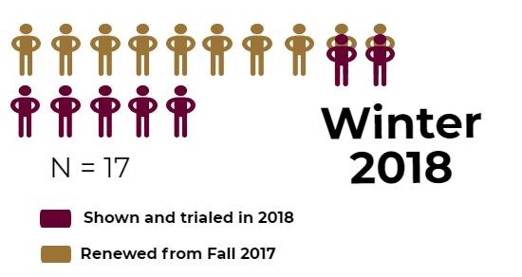
Sonocent Engagement

Slide 13
Themes from Student Feedback – Note-taking Winter 2018
Theme 1 – Under-using Sonocent – Note-taking Express
Theme 2 – Happily engaged with note-taking support, felt it increased course success
Theme 3 - Note-taking support not what was expected either in quality or quantity.
Theme 4 – Note-taking support not great for visual courses (math content) – both companies are addressing this.

Slide 14
Kurzweil Engagement

Slide 15
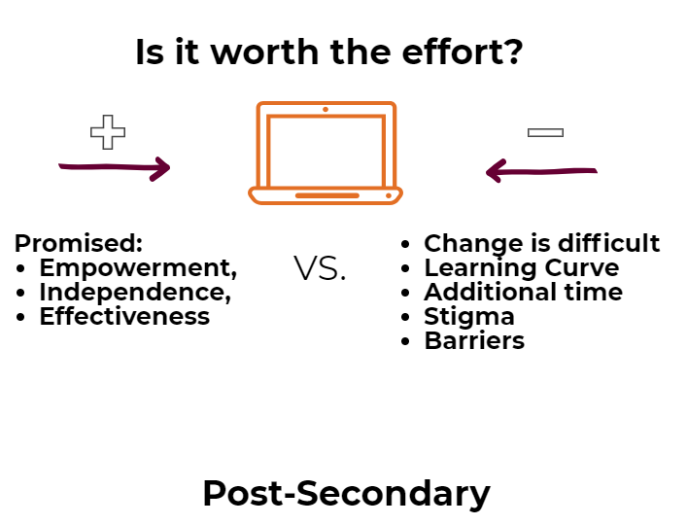
AT Abandonment Reasons
Same as K-12
Stigma associated with the tool
Prior experiences and training with AT
Barriers (environmental and intrapersonal)
Behaviour change is difficult
Disability-related

Slide 16
Implications of AT Abandonment
1. Loss of Institutional Resources:
Funding
Capacity
2. Negative impact on student success:
AT abandonment = Accommodation abandonment
3. Student need being unmet

Slide 17
Lessons Learned About AT Engagement
AT is a double edged sword (Cost vs. Benefit)
How much work is involved in this compared to what I will get out of it?
Behaviour change is difficult
What are the costs to my self esteem?
AT is not one-size fits all (provide a range of options)
Try before you buy (loaners, free subscriptions, trials)
AT training is a conversation

Slide 18
Our Response
Changes in training
Enhanced AT assessment and intake
Training as a continuum
Normalizing conversation and usage

Slide 19
AT Screening Tool
AT Screening Tool

Slide 20
Learning Skills Overview
Learning Skills Overview

Slide 21
Future Direction
Keep on measuring AT adoption and engagement
Can we continue to increase AT engagement?
Is our screening tool effective?
Qualitative data around student experience with AT in the post-secondary setting (barriers, perception)

Slide 22
Thank You
Questions or
Comments?

Slide 23
Resources Cited
Edyburn, D. (2005). Assistive technology and students with mild disabilities. In D. Edyburn, K. Higgins, & R. Boone (Eds.), Handbook of special education technology and practice (pp. 239-270). Whitefish Bay, WI: Knowledge by Design.
Fennell, J.M. (2016) Technology and Disability Identity: “Now you See Me, Now you Don’t” PhD Dissertation, York Universtiy, Toronto, ON
Forgrave, K. A. (2002). Assistive technology: Empowering students with learning disabilities. The Clearing House, 75(3), 122-126.
Hopkins, J. (2004). School library accessibility: The role of assistive technology. Teacher Librarian, 31(3), 15-18.
Kintsch, A., & DePaula, R. (2002). A framework for the adoption of assistive technology, in SWAAAC 2002: Supporting learning through assistive technology. Winter Park, CO: Assistive Technology Partners.
Reed, P., & Bowser, G. (2005). Assistive technology and the IEP. In D. Edyburn, K. Higgins, & R. Boone (Eds.), Handbook of special education technology and practice (pp. 61-77). Whitefish Bay, WI: Knowledge by Design.
Scherer, M. J. (2005). Assessing the benefits of using assistive technologies and other supports for thinking, remembering, and learning. Disability and Rehabilitation,27(13), 731-739.

